Slide 1
Academic Writing:
A Valuable Tool for your Studies and your Career
Margaret Trotta Tuomi, Ph.D.
Senior Researcher and Lecturer University of Jyväskylä, Finland

Slide 2
Academic Writing is a valuable skill needed for writing your
essays
reports
Master’s thesis or dissertation
scientific journal publications or books

Slide 3
Academic articles contain both content and structure
When you understand the structure of an academic article it will be much easier
to write your own articles and have them accepted by a journal
to find what you need from academic articles written by others

Slide 4
3 key text styles:
General to Specific text
Specific to General text
Narrowed text

Slide 5
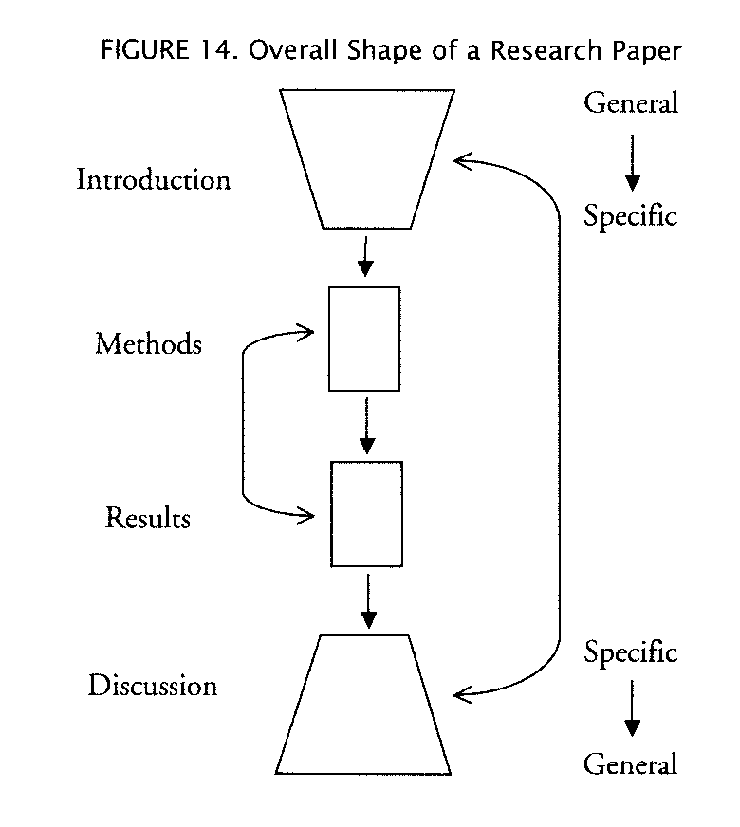
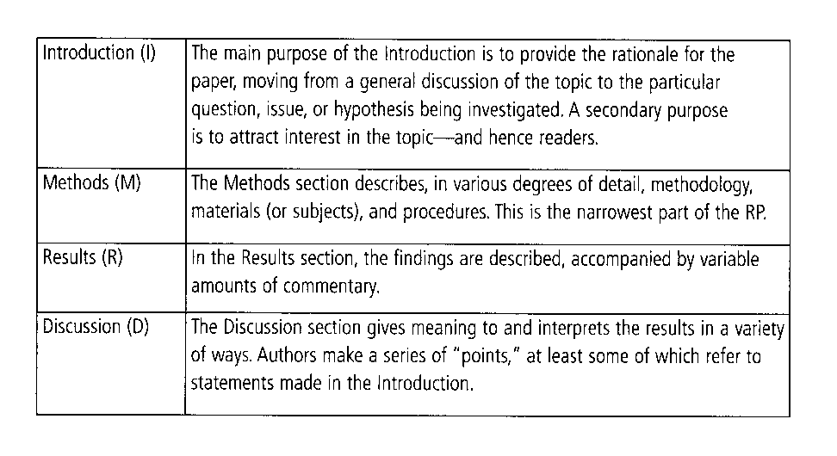
General Construction of a Research Paper

Slide 6
Start with Method Section
It is usually the place to start because it is the easiest.
What did you do?
How did you do it?
Who was your cohort?
Narrow Text is found in the Methods

Slide 7
Then continue with the results
Results comes next
What were your results?
Narrowed text is used in this section also
Sometimes combined with the Discussion
Appropriate discriptors of the data

Slide 8
Moves in Research Paper Introductions
The most difficult section to write
Some use statistics or definitions
Some use definitions

Slide 9
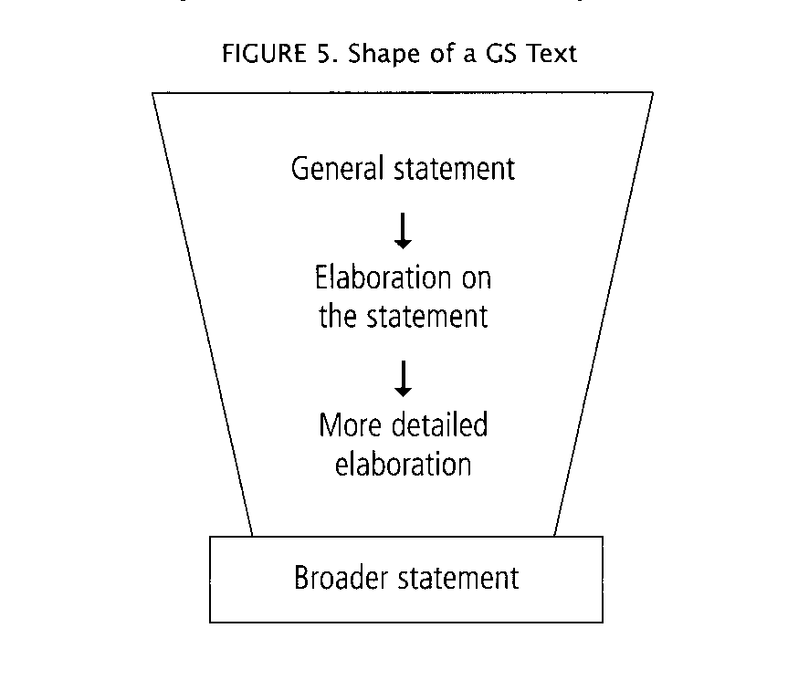
General to Specific text (GS)

Slide 10
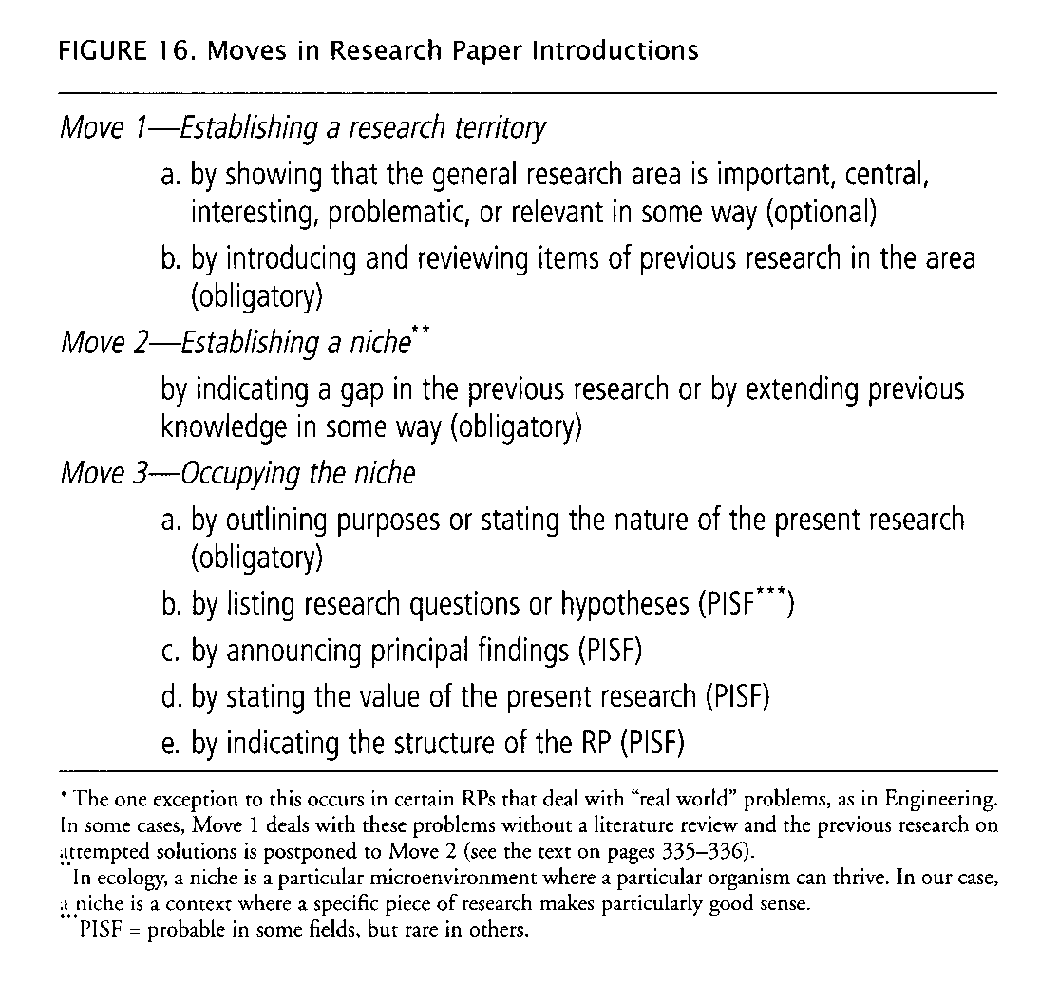

Slide 11
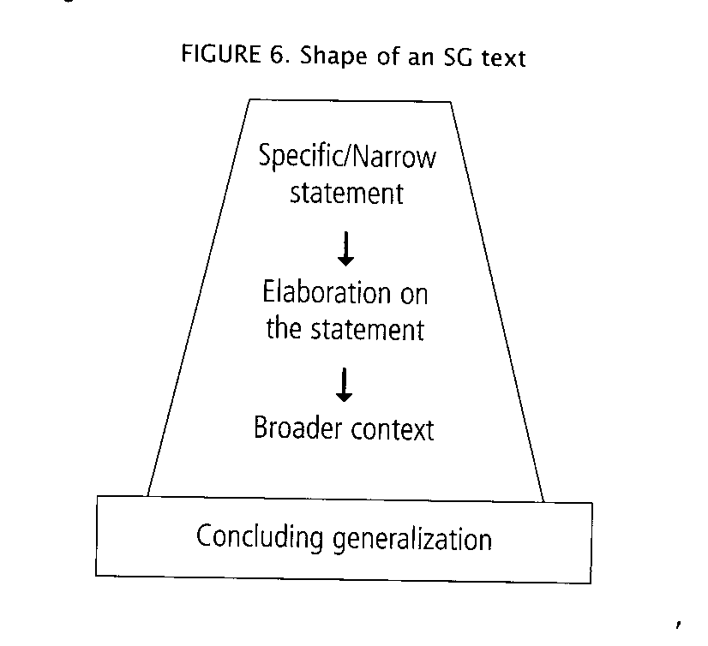
Specific to General Text (SG)

Slide 12
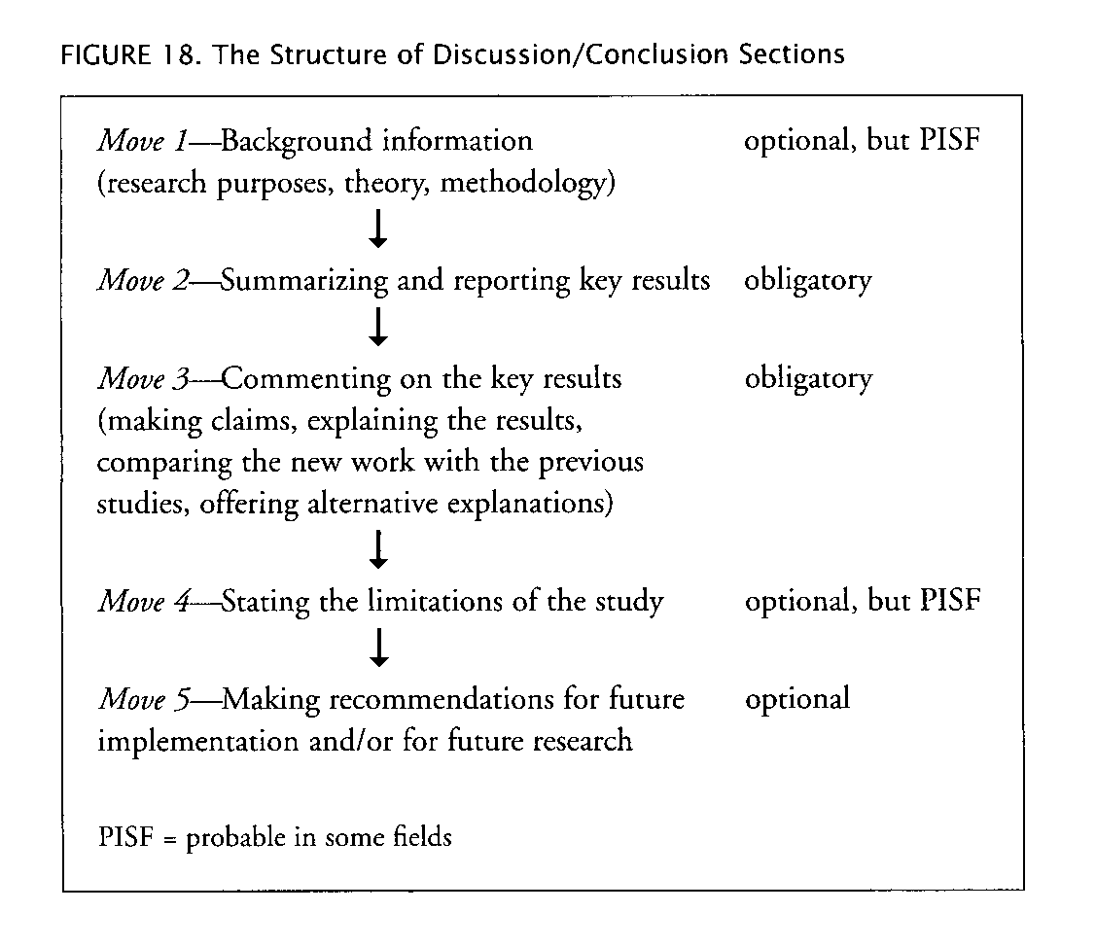
Discussion and Conclusion

Slide 13
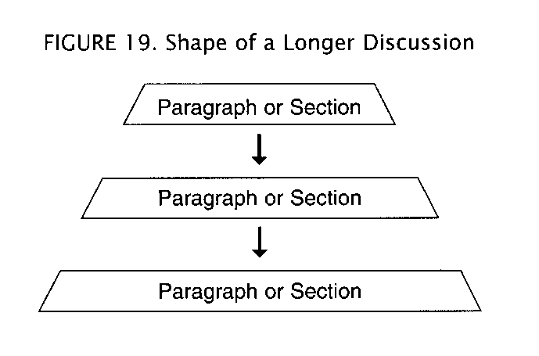

Slide 14
General Construction of a Research Paper

Slide 15
Title
Should say exactly what you did, not more, not less

Slide 16
Learning to write definitions is a good way to start
Consider your audience
Are they also professionals in your field?
The general public?
Should it be an extended or short definition?

Slide 17
The general structure of definitions:
+
Term (is/are) A horse is
a/an class that/+wh word an animal which
distinguishing detail which has been used as a means of transportation

Slide 18
Definition of a clock:
Clock (ordinary life definition): A gadget that has hands or numbers and tells you what the time is.
Clock (clockmaker's definition): An oscillator-based device for indicating the time visually or audibly.
Clock (scholarly definition): An instrument that is used to measure duration and co-ordinate events according to collectively determined units of time.

Slide 19
References
Swales, J.M. and C.B. Feak 2012. Academic Writing for Graduate Students: Essential Tasks and Skills, 3rd. Ed. Michigan Series in English for Academic and Professional Purposes.
Margaret Trotta Tuomi’s Web address http://users.jyu.fi/~ptuomi/

