Slide 1
Living with World Heritage – on the local discussions and politics 05.10.2016

Slide 2
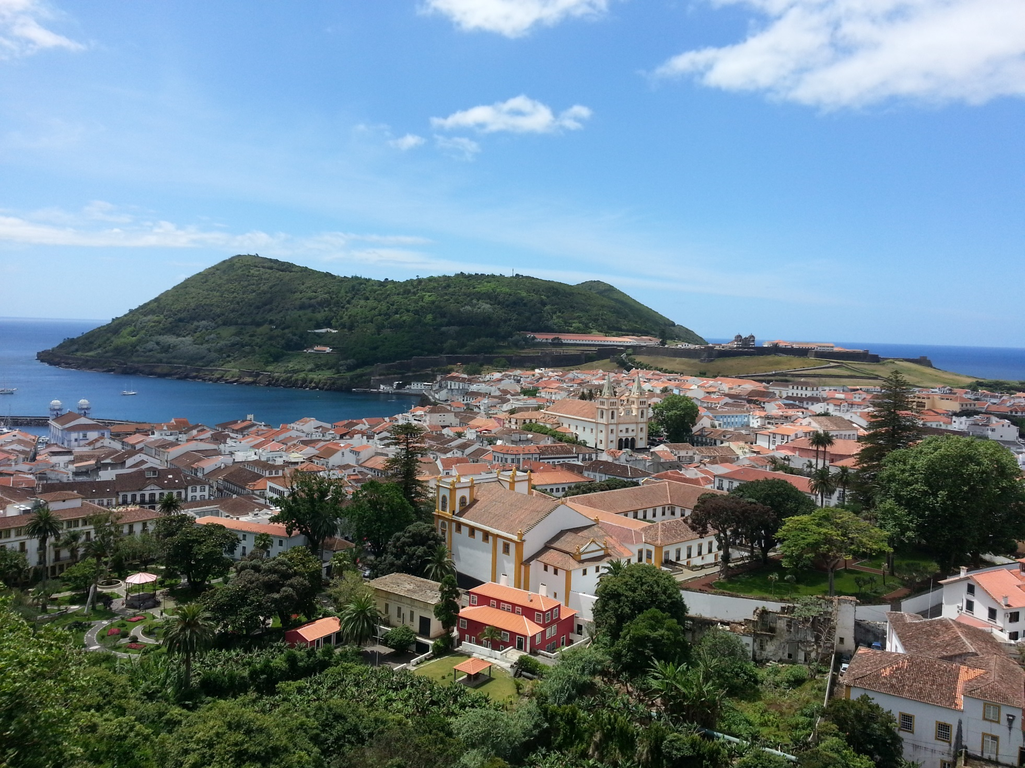

Slide 3
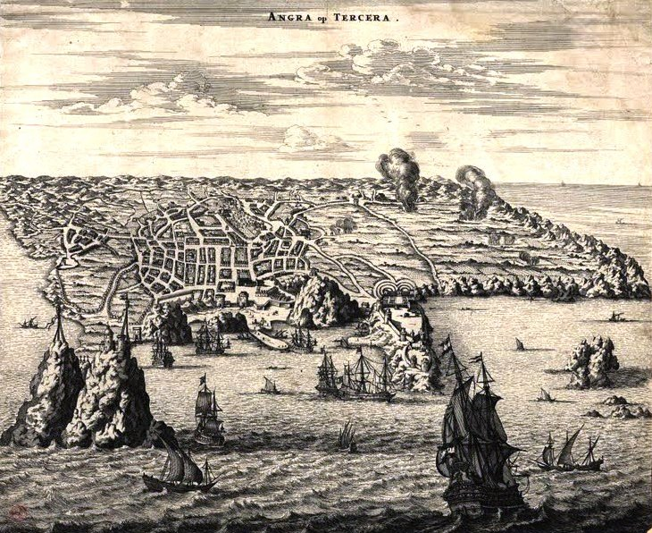

Slide 4
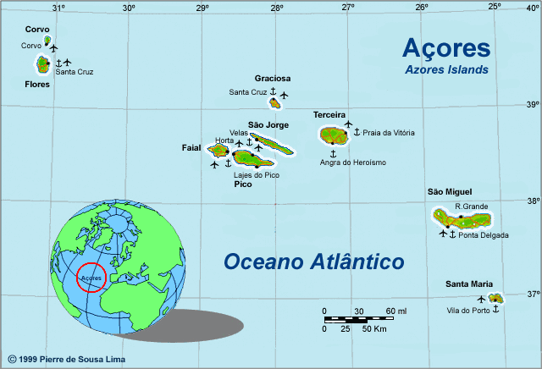

Slide 5
The earthquake 01.01.1980

Slide 7
Life in a World Heritage City A case study of discussions and contested values in Angra do Heroísmo, the Azores

Slide 8
Research questions
Critically map and analyse past and current discussions, negotiations and social processes that take place and relate to conditions created by living in- or monitoring the World Heritage City of Angra do Heroísmo.
The purpose is to study how, and with what result and consequences, contested values, interests, rhetoric and powers are mobilized and made into dynamic forces for stakeholders in the city.

Slide 9
Angra do Heroísmo has always been, throughout its history, a City of the World. In December 1983, it became the first Portuguese city inscribed in the UNESCO’s World Heritage List. As all historical cities, Angra do Heroísmo had its ups and downs. In the past century’s last decade it even became part of the cities group in risk of being cast out of the UNESCO’s World Heritage List. Territory resource management’s conservative politics and attempts of museum like treatment of the city, moved away the inhabitants. The definition of a coherent urban policy allowed the city’s maritime front recuperation. (Luís Mendes former vice-president of Angra do Heroísmo municipality 2005:7)

Slide 10
RESIDING IN- AND MANAGING A WORLD HERITAGE CITY – LIVING IN, WITH AND BY HERITAGE
A living historical urban place is especially demanding
Why?
It is constantly exposed to pressures engendered by the needs of upgrading infrastructure, service- and housing facilities to current standards.

Slide 11
“take the appropriate legal, scientific, technical, administrative and financial measures necessary for the identification, protection, conservation, presentation and rehabilitation of this heritage” (UNESCO, 1972, Article 5).

Slide 13
Sufficient preservation, good living conditions and flourishing commerce – how to balance it all?

Slide 14
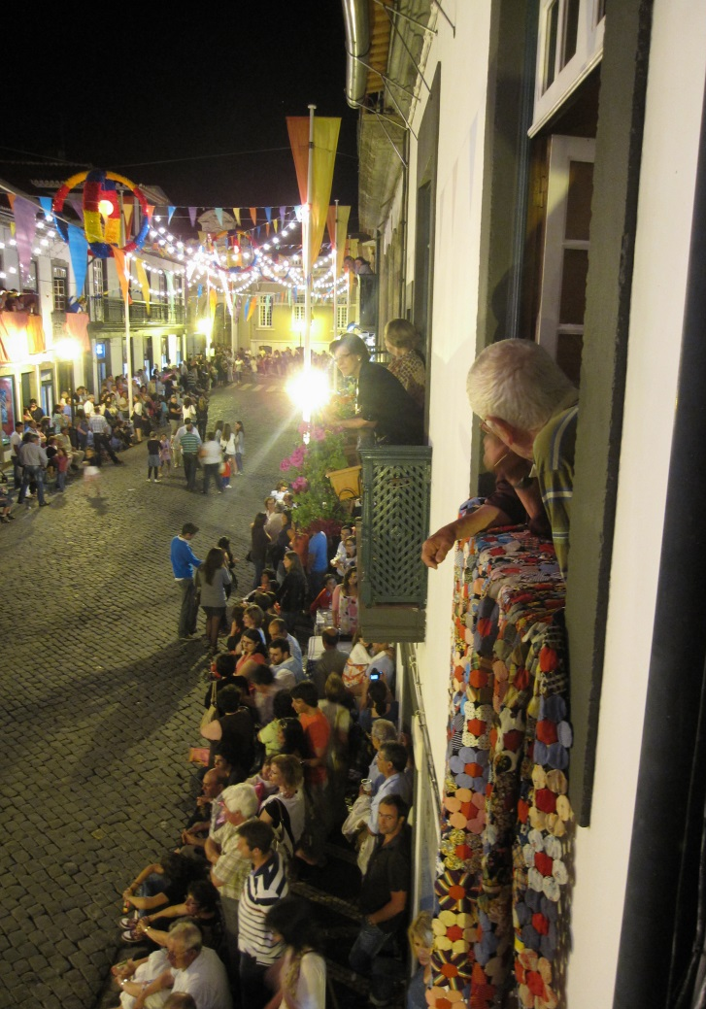
“The goal is…is for Angra to be inhabited”

Slide 15
The “Gabinete” – the closure of the Conservation Office
“For political reasons. […] Because they were putting limits and they were creating problems. They created problems, and as a consequence it was closed” (Interview 19)
[There was a] lack of respect for the users who did not have the answers in time to solve their life. Often these people had a bank loan and were paying interest, and the office in town could not give them the answers they wanted [/assumed]. (Interview 25)

Slide 16
The closure of the Conservation Office – a democratic decision?

Slide 17
When details cause polemics

Slide 18
Traditional materials

Slide 19
[…], but the thing is with the huge winds and the velocity of the winds that come every year to this island, of course that this is not the best architectonical solution, so sometimes it rains inside of the people’s homes like in my home. (Interview 3)

Slide 20
The traditional materials are causing practical problems
The inhabitants find their own solutions
It is created a front stage and a back stage in the city

Slide 21
The second earthquake…

Slide 22
They are let alone in the middle of the desert, and they start solving their own problems. How can you solve it? Change! The heritage is a bad guy, the heritage office, the heritage cabinet, DRAC, the municipality, they are the bad guys because they are obliging us, pushing us to keep on using wood, and termites will eat wood. (Interview 27)

Slide 23
Legitime og illegitime power
Room for action
Mismatch between preservation ideals and practice

Slide 24
“The Gym” – Maintaining a business within the classified area
Restrictions in terms of signs and advertisements
Lack of parking space in the city
Difficulties with deliveries
Limited possibilities to adapt the restaurant to the needs of disabled people
The World Heritage and the historical setting is also important for business

Slide 25
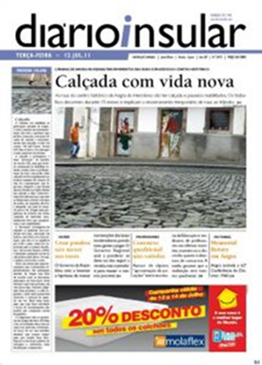
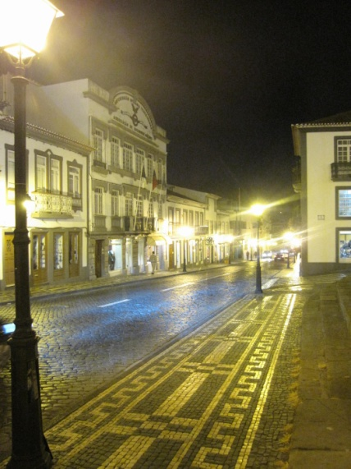
When the pavement is causing debate…

Slide 26
“Are the inhabitants to suffer in order to maintain the heritage when the only purpose of this stone is to strengthen the historical look of the city?”

Slide 27
“Out With the Pavement –
Save the Human Lives”

Slide 28
“The streets in Angra are a shame. Don’t try that World Heritage thing”.

Slide 29
“World Heritage is also about […] fulfilling accessibility”.

Slide 31
A Pseudo-historical outlook?
«Heritage alters the past»
It upgrades (improves how it used to he)
It updates (preserve heritage according to modern preferences)
It forgets (it forgets the unpleasent)
It reshapes (reshapes so that we (modern people) can embrace it and consume it)
(Lowenthal 1998)

Slide 32
Modern development in a World Heritage City – possibilities and limitations

Slide 35
[UNESCO] shouldn’t have let them construct it, because it took away the image of the Bay of Angra. It took away the image of Angra that we once had. [T]here are several other places where they could have constructed the marina, […] with a modern design like they wanted it. (Interview 24)

Slide 36
Arguments
For
Economic reasons
Cultural and historical reasons -
Revitalisation of the bay
Functional authenticity
Socially important
Against
Preservation of the original marina.
Preservation of the archaeological remains
Aesthetical «problems» with the new marina
Have not revitalized the bay

Slide 37
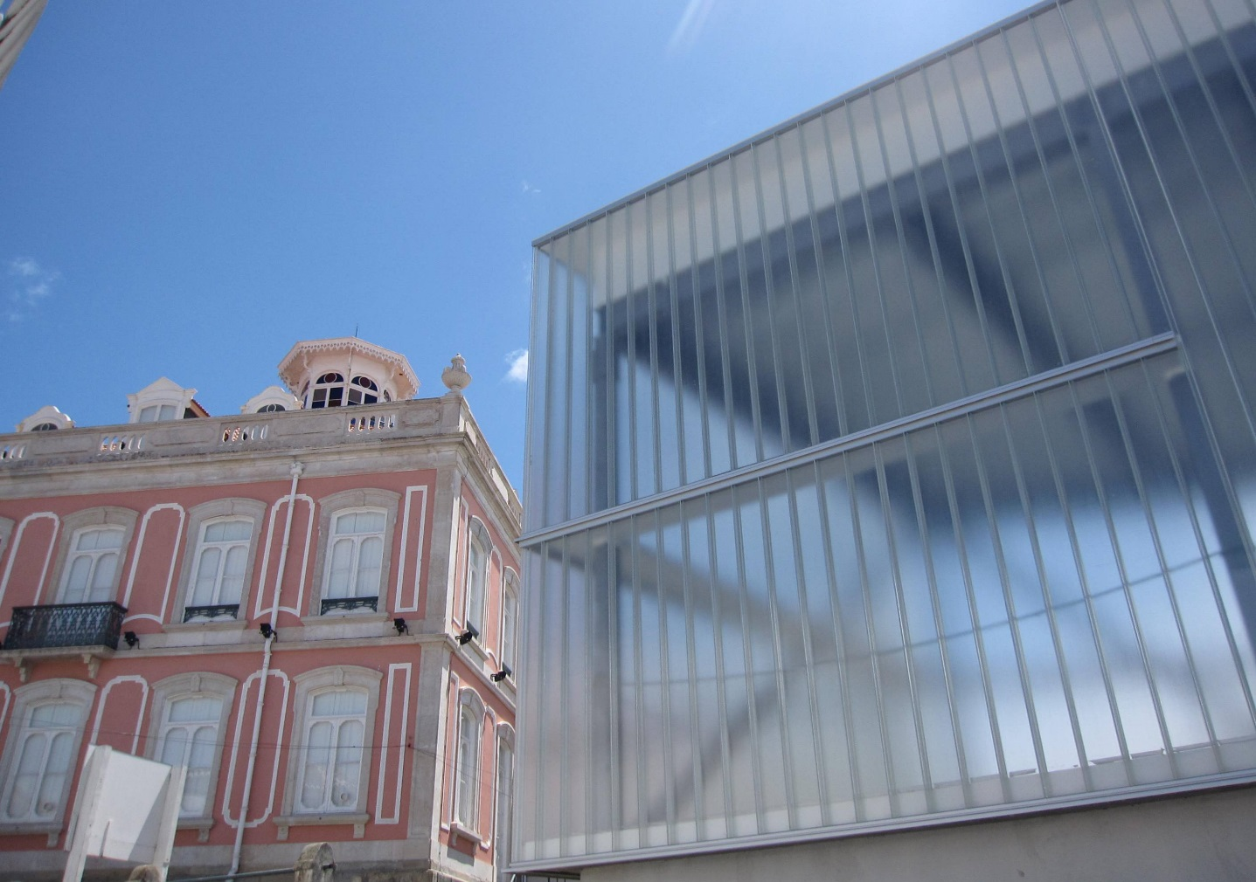
“Let’s put salad and tomatoes or something in it, but not books!” Contemporary architecture in the midst of a Word Heritage City – on the polemics

Slide 38
Oi! It is horrible. It is. It does not bother me to have a library next to my house, but not that building. This building is horrible: It doesn’t have anything to do with the city, in this environment. They should have made it in a more traditional style […] it would have been much better. […] Because that building is horrible – it looks like a greenhouse. Let’s put salad and tomatoes or something in it, but not books! (Interviewee 20)

Slide 39
“What is important, and what I have always defended, is that every generation should leave a mark from its time” (Interview 25).

Slide 40
“So, I can’t put that (pointing at an aluminum window), but they can build that monster right in front of me”.

Slide 41
I think there is no monitoring of the World Heritage organization … UNESCO. See the works that are done here. That hotel and [the new library]. Please enforce or send somebody to see these houses, but nobody is coming [...]. (Interview 30)

Slide 42
Front stage and back stage/centre and periphery
Front stage: historical, the homogeneous and traditional cityscape where the “past” is significant.
Back stage:contemporary projects, being more industrial or commercial, having less restrictions and being a more diverse area.

Slide 43
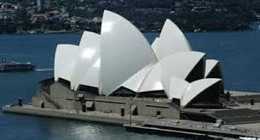
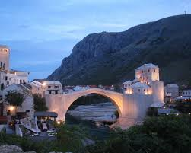
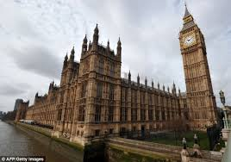
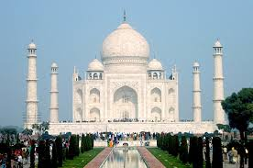
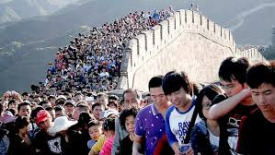
Tourism and World Heritage

Slide 44
World Heritage sites may be popular sites prior to a classification
Limited branding and awareness of World Heritage Status
Competing brands
Sites may simply not be of touristic interest
Some sites do experience increased influx of tourists after a World Heritage Classification

Slide 45
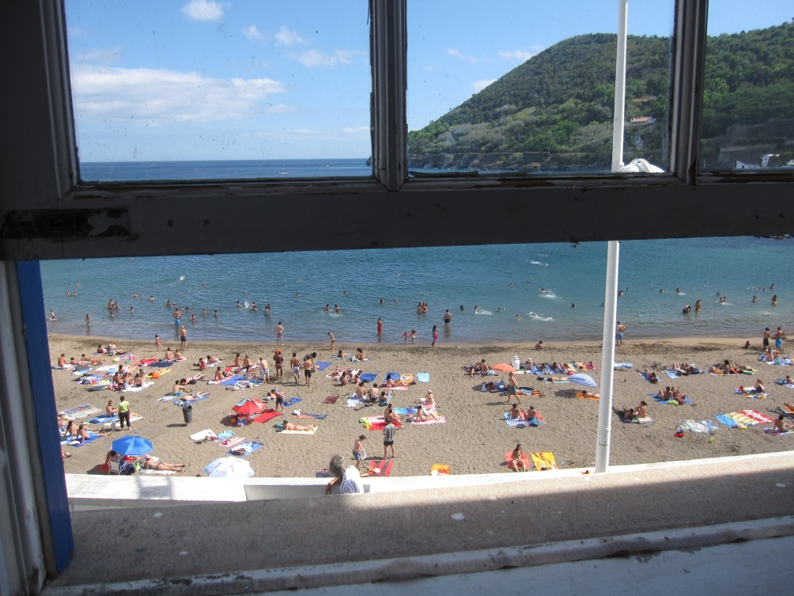
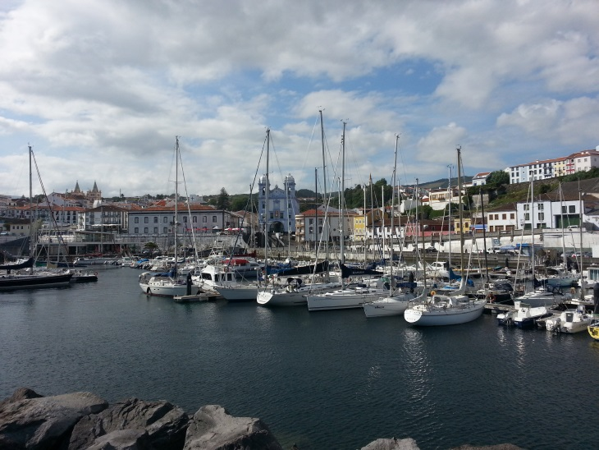
Tourism in Angra do Heroísmo

Slide 46
«What is the greatest reason for visiting Angra? Undoubtedly, it is because it is a World Heritage City»

Slide 47
“… here it is all informal. People are not asking me for things or “amigo come and buy this” or nobody is bugging me. I am being relaxed, you know. I feel like I am in this…right in the Azorean society. [...] just blend right in”.

Slide 48
Tourism in Angra do Heroísmo =
positive as long as it is sustainable, and as long as it does not lead to a massive influx of tourists.

Slide 49
Branding World Heritage

Slide 50
“I haven’t seen this information – these inscriptions – still not seen it”.
“I don’t remember if they have any UNESCO signs”.
“If you don’t remember maybe it is not enough?”

Slide 55
“…it doesn’t really jump out on you. It’s subtle, it is subtle. You know the airport does not have flashy neon signs written World Heritage Site. You have to ”Oh, wow, really?” So, I find it refreshing, actually”.

Slide 58
Factors affecting the limited influx of tourists to Angra do Heroísmo
Lack of resources to promote
Lack of strategy/aspiration to attain more tourists
Accessibility
Competition from other islands

Slide 59
“Importantly, the primary restriction which exists for tourism in the Azores are the air fares. Period.”

Slide 60
Workshop
Task: Make a presentation of a World Heritage Site that you have visited. Reflect on the aspects of management (development and preservation),politics, stakeholders, tourism and branding.

