Slide 1
YFIA205 Basics of Research Methodology in Social Sciences, 5 cr.

Slide 2
Programme
Autumn 2016:
1. Petteri Niemi: Science, knowledge and theory, Mon 31 Oct (OPK 141 10.15-)
2. Pertti Jokivuori: Empirical social science, Thu 3 Nov (OPK 141 ; 14.15-)
3. Tuija Virkki: Qualitative research & assignment of qualitative exercise, Mon 7 Nov
(OPK 141 10.15-)
4. Pertti Jokivuori: Introduction to quantitative research, Thu 10 Nov (F 106;14.15-)
5. Pertti Jokivuori: Quantitative research, data analysis, Mon 14 Nov (X 151;10.15-)
6. Pertti Jokivuori: Quantitative research, data analysis, Thu 17 Nov (OPK 139;
14.15-)
7. Marjo Kuronen: Qualitative research , Mon 21 Nov (OPK 141; 10.15-)
8. Marjo Kuronen : Qualitative research, Thu 24 Nov (F 106;10.15-)
9. Tuija Virkki: Qualitative exercise, feedback discussion Mon 28 Nov (OPK 141;
10.15-
10. Exam: Thursday 1 Dec F 106 14.15 – 15.45

Slide 3
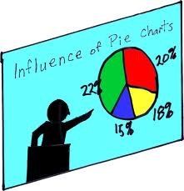
Content of the lecture: Empirical social science
1 Basic Terminology
II Intro to Social Research Methods

Slide 4
Research
In common parlance research refers to a search for knowledge
Scientific and systematic search for essential information on a specific topic
An art of scientific investigation
Human activity based on intellectual (scientific) method during the investigation of matter

Slide 5
Research

Slide 6
OBJECTIVES OF RESEARCH
The purpose of research is to discover answers to questions through the application of scientific procedures
The main aim of research is to find out
true knowledge
Knowledge that is hidden or not yet been discovered
deepen understanding of a topic
test if the earlier knowledge (theory) is still valid/ to improve theory
Kothari, C.R.. Research Methodology : 2004.

Slide 7
Methodology
Generally a guideline for solving a problem
with specific components such as phases, tasks, methods, techniques and tools
More precise definitions, which refer to the study of methods:
The analysis of the principles of methods, rules, and postulates employed by a discipline
The systematic study of methods that are, can be, or have been applied within a discipline
The study or description of methods
The rationale and/or the philosophical assumptions that underlie a particular study or a particular methodology (for example, the scientific method).

Slide 8
Scientific method
A series of steps taken to get knowledge
A body of techniques for investigating phenomena, acquiring new knowledge, or correcting and integrating previous knowledge
To be termed scientific, a method must be based on gathering empirical and analysis-enabling evidence subject to specific principles of reasoning
The Oxford English Dictionary says that scientific method is:
"a method of procedure that has characterized natural science since the 17th century, consisting in systematic observation, measurement, and experiment, and the formulation, testing, and modification of hypotheses."

Slide 9
Empirical
A central concept in modern science
The evidence must be empirical, or empirically based
Dependent on evidence or consequences that are observable by the senses
Denotes information gained by means of observation or experimentation.
Empirical data is data produced by an experiment or observation (questionnaire)

Slide 10
The empirical research process (step by step):
Formation of the topic
Theoretical framework, literature review (essential previous research/results of a topic) & the analysis of concepts
Identification of research problem/ Hypothesis
Gathering of data
Analyzing and interpreting the data
Reporting and evaluating research: Conclusions
Step order may vary depending on the subject matter and researcher
Glenn, Jerome Clayton. Handbook of Research Methods. Global Media, 2010.

Slide 11
The empirical research process

Slide 12
The empirical research process

Slide 13
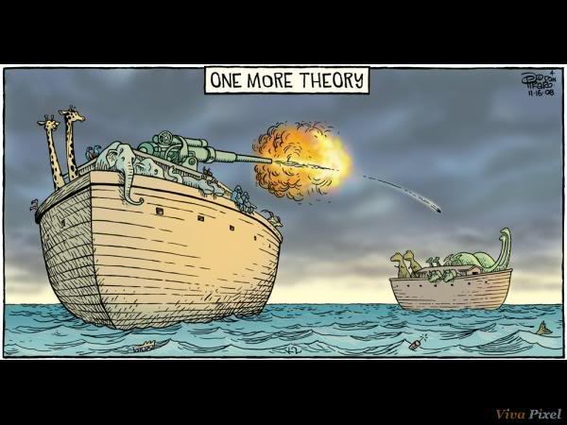
The empirical research process

Slide 14
Positivism as background of empirical orientation in social sciences
In 19th century: counter movement against metaphysics, natural philosophy and speculative philosophy
Speculative philosophy makes claims that cannot be verified by everyday experience of the physical world or by a scientific method
Positivism: The only authentic knowledge is that which is based on sense, experience and positive verification
Auguste Comte (1798–1857) saw the scientific method as replacing metaphysics in the history of thought
Sociological positivism was later reformulated by Émile Durkheim (1858–1917) as a foundation to social research
At the turn of the 20th century the first wave of German sociologists, including Max Weber (1864 –1920) and Georg Simmel (1858 – 1918)rejected the doctrine, thus founding the antipositivist tradition in sociology
→ Two Camps: quantitative & qualiative research-orientations

Slide 15
Research strategy
Qualitative
inductive
generating of theory
interpretivism, i.e. individuals interpreting their social world
constructionism, i.e. social reality as constantly shifting creation of individuals
Quantitative
deductive
testing the theory
positivism, i.e. resemblance to natural scientific model
social realism and objectivism; external reality

Slide 16
Qualitative vrs. quantitative research
Distinction may be artificial as both can be used in the same study
Qualitative orientate towards understanding, interpretation, subjective experience, intersubjective meanings, social processes, contexts and cases
Quantitative towards measurement, causality, generalization, replication and large population by using statistical methods

Slide 17
Thank you for your attention!

