Slide 1
Introduction to cultural policy
Wednesday 4.10.2017 Ylistökem 3
Aleksi Lohtaja
Doctoral student

Slide 2
About my research
"Even though Cultural policy as part of public policy is carried out at all levels of government, the overwhelming amount of the academic research focusing on urban space demonstrates that the prime site of cultural policy development in the past thirty years or more has been the city (Bell & Oakley 2014)”
My research interest related to cultural policy:
Social turn of art
Relationship between art, politics and critical philosophy
Architecture and design as cultural politics
Urban commons
Urban cultural development - critical perspective
Guggenheim-conflict in Helsinki and Abu Dhabi
Gentrification
The criticism of tourism as a struggle for local community

Slide 3
Utopia as method
Alongside cultural policy, I work as a doctoral student in research project ”Utopia as method. Articulations for societal change”
Funded by Kone foundation 2017–2019
https://utopiametodina.wordpress.com/
My research focuses on the connections of critical social theory and architecture articulated in the form of utopia
Utopia as method -project is overwhelmingly happy to host Professor Erik Olin Wright at the Department of Social Sciences and Philosophy, October 10-13.
On Wednesday the 11th of October we organize Real Utopias Symposium in C5 (see: https://www.facebook.com/events/1876946305966316/?fref=ts).
On Thursday the 12th of October there is going to be an open YFI-Forum lecture by Professor Wright with the title A Framework for Emancipatory Social Science. The lecture will take place at 14-16 in S 204.

Slide 4
My current research project: Bauhaus and Critical theory
2019 marks the centenary of the foundation of design and architectural school Bauhaus (1919–1933), which is considered to be the greatest design movement of 20th century. And as many have argued, the ideas of Bauhaus are worth taken into considerations even 100 years after.
Regardless that we are familiar with famous Bauhaus objects and buildings, ultimately the most important design object for Bauhaus was a utopian vision of the future society that would surpass the contradictions related to scarcity, production, consumption and unequal lifestyle between different social classes.
Nearly 100 years after its foundation, the idea of Bauhaus is often associated to socially-engaged and public-interest architecture addressing global social, ethical, and ecological problems. This connection between Bauhaus and new forms of ‘social architecture’ is often done by deliberate choice: there is a discussion of new green Bauhaus, digital Bauhaus, Ikea Bauhaus, and so forth.
Bauhaus has multiple parallels with philosophical discourses on the nature of modernity and the commodification of everyday life experience as well.
Especially in 20th century critical theory, also known as Western Marxism, there are multiple (critical) notions relating to the utopian aspirations of Bauhaus
In this study, which is the first to look at this connection in comprehensive ways, I argue that both, theoreticians associated with critical theory and members of Bauhaus, share very similar epistemological assumption on modernity, modernization and modernism. This shared assumption is the reification of everyday life experience after the First World War which led to commodification of everyday objects as an outcome of technical improvements in industrial production.
However, the conclusions of this shared epistemological understanding of modernity are paradoxically entirely opposite between Bauhaus and philosophers associated to critical theory. According to Bauhaus it was a way for inventing a utopia of new modern society. According to members of critical theory it was the point of departure when many utopian energies of especially early avant-garde movements became instrumental which eventually led the total collapse of any optimistic understanding of modernism.

Slide 5
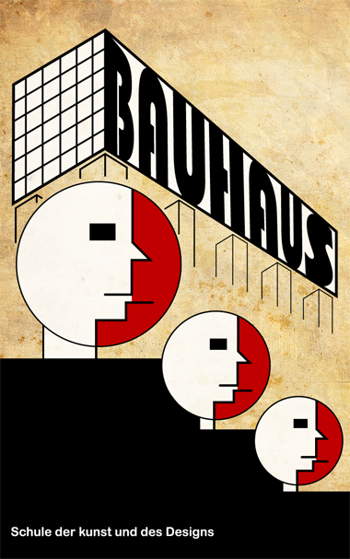
Bauhaus
Industrial production of everyday objects
Bauhaus is often associated with the idea of formulating new social utopia by making objects and forms that are reduced to the certain degree that is really needed. Therefore, their project thus interacted with Le Corbusier (architecture’s possibility to stabilize society and its class relations), and Nordic functionalism (where the formations of democratic welfare state -ideologies became to emerge). The roots of the school lies in inventing new forms not only for the sake of aesthetic but for the sake of designing new society.
The idea of “Bauhaus style” is modern equivalent for the earlier ideas of Gesamtkunstwerk: the design process from single chair to entire city should follow the same formal principle. To Bauhaus this principle is function instead of decoration.
Bauhaus operated in Weimar, Dessau, and Berlin during the years 1919–1933 and was directed by three notable architects Walter Gropius (1919–1928), Hannes Meyer (1928–1930), and Ludwig Mies van der Rohe (1930–1933). Every city and director gave particular nature to Bauhaus idea but generally there are three crucial interrelated themes that formulated the distinctive nature of Bauhaus cultural politics:
Avant-gardist influences from Soviet Russia
The political spectrum in Weimar Republic: “Weimar as laboratory”
Utopian aspirations from new technologies and industrial production.

Slide 6
”Bauhaus challenge”
The primary purpose for my research is to study how the social utopia of Bauhaus understood in 20th century critical theory. I argue that there are especially two eras when Bauhaus has been debated from critical point of view. First era arose from the foundation of Frankfurt School in Weimar Republic (1918–1933). The problem of Bauhaus was mainly discussed by associates from the outer circle of the Frankfurt school, by Ernst Bloch, Siegfried Kracauer, and most importantly Walter Benjamin.
The second wave of reading Bauhaus from critical theory point of view took its place in French Marxism in 1970’s when the nature of commodification, reification and industrial production changed their nature radically. Key thinker here is especially Henri Lefebvre, whose work relating to the critique of everyday life, architecture, and urbanism influenced also his colleagues and former students, most notably Jean Baudrillard and Guy Debord.
This connection between Bauhaus and critical theory in broad sense will be discussed in general as well but I will primarily focus on Walter Benjamin’s and Henri Lefebvre’s critical encounter with Bauhaus.

Slide 7
Frankfurt school and Bauhaus
First era of “Bauhaus challenge” in critical theory is to be understood as a part of broader question of modernism as social antagonism between repression and emancipation in the theory of early Frankfurt school.
Frankfurt school
School combining social theory (especially sociology) and critical (Marxist philosophy)
Members: Theodor Adorno, Max Horkheimer, Walter Benjamin, Erich Fromm, Herbert Marcuse…
Critique of mass society and cultural industry
Adorno & Horkheimer: Dialectic of Enlightenment
There was no consensus among the theoreticians involved in Frankfurt school over the ultimate meaning of Bauhaus. This is a part of broader “Adorno-Benjamin -debate” over the meaning of the ‘work of art in the age of its technological reproducibility’.

Slide 8
Walter Benjamin (1892–1940)
An outsider of Frankfurt school
Best known for his essay The Work of Art in the Age of Mechanical Reproduction (1936)
How is art produced in industrial society
Aura vs. technology in art
Photography, cinema and modern architecture as paradigmatic forms of art in industrial society
Benjamin’s thinking on the technological change and modernization in society is connected to the concomitant changes in the forms of artistic production and political struggle
Shock as defining phenomena of modern life experience
Bauhaus for Benjamin: a possibility for radical “destructive culture” after WWI

Slide 9
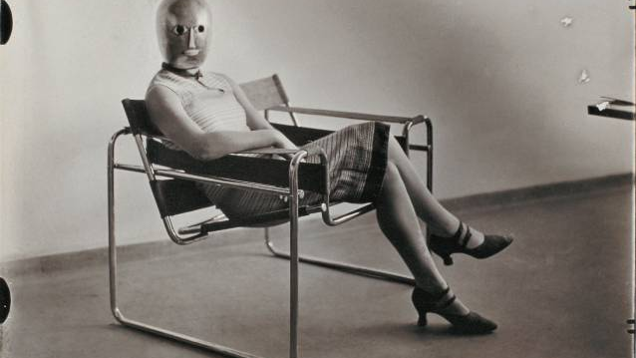
Walter Benjamin
”Barbarism? Yes, indeed. We say this in order to introduce a new, positive concept of barbarism. For what does poverty of experience do for the barbarian? It forces him to start from scratch; to make a new start; to make a little go a long way; to begin with a little and build up further, looking neither left nor right.”
(…)
”This has now been achieved by Scheerbart, with his glass, and by the Bauhaus, with its steel. They have created rooms in which it is hard to leave traces.”

Slide 10
Universitas project
If Bauhaus interested Frankfurt school scholars from the point of view of modernity and industrial production attached to it, the second phase of “Bauhaus challenge” especially in French social theory took place at the precise moment when mass-production-based industrial society faced profound legitimation crisis in the beginning of 1970’s.
What is French social theory? See François Dosse: History of Structuralism vols. 1–2.
The crisis led to new understanding of society which eventually became to be known as post-industrial or post-Fordist society. But in the first analysis it was often understood as consumer society, whose theoreticians are often associated to critical theory of early Frankfurt school. They took similar way the task of explaining what is the role of commodities as social relations in everyday life experience.
My research relating to this second phase will focus especially on the data related to a conference called “Institutions for a Post-Technological Society: The Universitas Project” which was held at New York’s Museum of Modern Art in January 1972 and gathered many French thinkers to discuss with design theorist from the United States.
Conference was organized by curator Emilio Ambasz. Acknowledging that the questions of design and architecture are too important to be left to the designers alone, he invited scholars from multiple theoretical fields to submit research papers for the conference. Among the invitees outside of design theory were for instance Henri Lefebvre, Alain Touraine, Michel Foucault (who declined the invitation), Umberto Eco, Manuel Castells, Jean Baudrillard, Hannah Arendt, Louis Althusser (who declined), Roman Jacobson (who declined), and Roland Barthes (who declined).
The conference was organized with an ambitious goal to understand the role of design and its relation to society. Generalizing it could be said that the conference was trying to invent a new Bauhaus for post-industrial society.
According to Ambasz himself the purpose was to sketch contours for possible “experimental university” that would connect critical theory to the education of architecture and design. This reminds of course Bauhaus that institutionalized similar way new educational program for design. This connection was manifested in the conference for instance by historian Carl Shorske stating that there is clearly a “shadow of the Bauhaus as an institution hovering around the Universitas project”.

Slide 11
Henri Lefebvre (1901–1991)
Marxist philosopher of everyday life and urban space
Key theme: qualitative change of capitalism
Critique of Everyday life
Right to the City
The Production of Space
Bauhaus and Lefebvre?
Being perhaps philosopher with greatest interest to the fields of urbanism, architecture and everyday life conditions, Lefebvre has discussed the meaning of Bauhaus in many places.
What is mainly considered to be his understanding of Bauhaus is that there is a certain disappointment in the outcomes of the movement. The revolutionary ideas of Bauhaus and the social utopia they proposed turned into the service state-led capitalism.
While this is doubtlessly the core of Lefebvre critical reading of Bauhaus, I argue that Lefebvre’s reading of Bauhaus is more complicated and ambiguity.

Slide 12
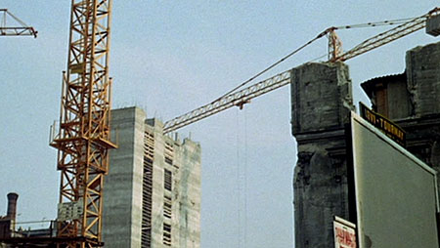
Henri Lefebvre
“We can take some inspiration from Bauhaus, from the previous rebellions, from communities and other form of knowledge, but what I would like to offer as a conclusion is that the problems are new, and the science we are after is unknown”.

Slide 13
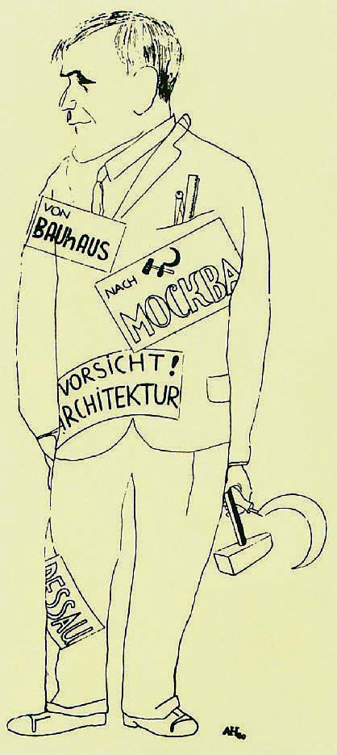
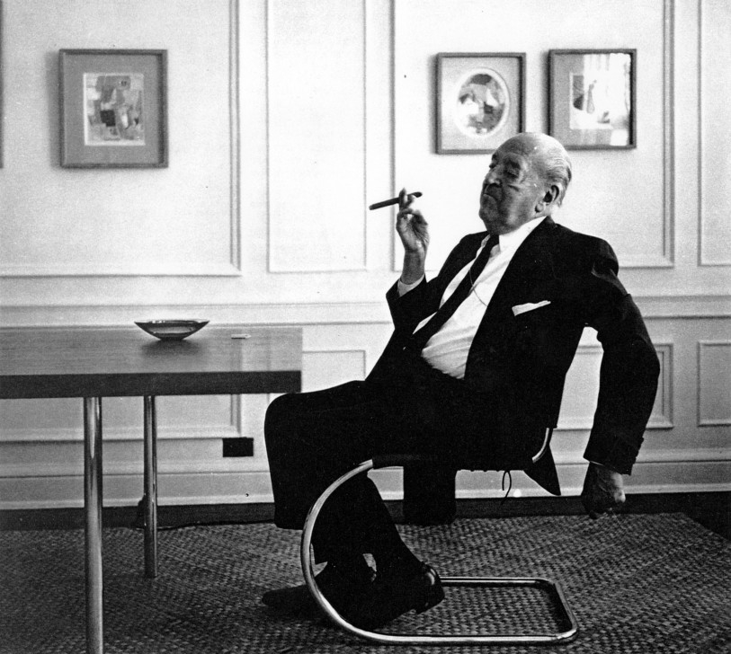
Contested representations of Bauhaus

