Slide 1
“Political” Emotions: 1 Basic Analytical Concepts: The Nature of Phenomenological Analyses
Sara Heinämaa
University of Jyväskylä

Slide 2
Phenomenological philosophy
We are heading towards philosophical analyses of emotions and we will discuss philosophical theories of emotions,
not empirical theories, developed in sociology, psychology, cognitive sciences, cultural history, evolutionary biology…
= empirical sciences that illuminate the natures, functions and operations of emotions in many important ways but without philosophical interests, goals, tasks.
WHAT IS THE DIFFERENCE, WHAT IS SPECIFIC TO PHILOSOPHY?
• Philosophy does not produce causal explanations or empirical (experimental) theories but produces intentional (and conceptual) analyses of experiences (e.g., emotions, beliefs, desires, hopes, valuations, decisions, volitions…), analyses of their intentional structures and relations of dependency,
• So, when philosophy studies experiences (in phenomenology and pragmatism), it does not base its claims, theories and conclusions on experiences, it does not derive its truths from experience, but aims at clarifying and explicating the general structures of experiences,
=> Whose experiences? Mine, yours, ours, everyone’s…?
• Philosophy does not generalize over actual experiences but makes claim about all possible experiences, imaginable and thinkable.
For example, a philosophical analysis of RAGE…
Notes:
The three most frequently used measures of brain activity are functional Magnetic Resonance Imaging (fMRI), magnetoencephalography (MEG) and electroencephalography (EEG).
Euripides’s tragedy Medea: After ten years of marriage, Medeia’s husband Jason abandons her to wed King Creon’s daughter Creusa. He also banishes Medea and her sons from Corinth. In revenge, Medeia murders Creusa with poisoned gifts. Later, she murders her own sons by Jason.

Slide 3
An exemplary philosophical analysis of RAGE
• When we study rage and its political significance philosophically, we do not perform interviews or compose experiements (psychological or neurological). We do not need to treat our fellow people or ourselves as empirical material and we do not need any recording tools, laboratories, electromagnetic measuring instruments.
• We start from a particular case of rage – own or alien, real or fictional –, and we vary the experience in thought and imagination, trying to determine its limits and discover its necessary features, i.e., the features without which it would not be what it is: an instance of rage.
• We may focus on one case, or may work with a set of carefully selected cases. We treat them all as mere, “pure” examples – like geometrians use particulal triangles when they construe their theses and theories about triangles. The geometers aim at capturing exceptionless truths about triangles, truths without exeptions.
• Methodologically the work of the philosopher, the phenomenologist – our work here –, is more akind to that of a mathemarizian or a logician than to a sociologist or a psychologist. Like the geometrician, we too aim at exceptionless universal claims (in our work here, claims about the structures of experiences).
• The philosophical task of varying the chosen example(s) in imagination and thought also bears similarities with the work of artists who paint, picture or describe imaginary persons in imaginary situations and imaginary worlds.

Slide 4
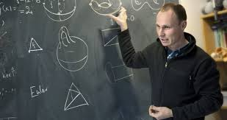
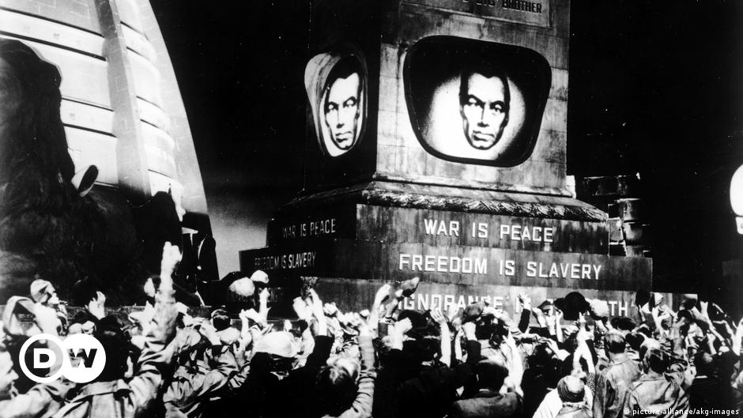
1931 1949 1984
Brave New World Nineteeng Eighty-Four The Handmade’s Tale
Notes:
E.g., Aldous Huxley’s Brave New World (1931), George Orwell’s Nineteen Eighty-Four (1949), Margaret Atwood’s The Handmade’s Tale (1985).

Slide 5
“We can draw extraordinarily much profit from what history has to offer us, and in still richer measure from the gifts of art and particular of poetry. These are indeed fruits of imagination, but in respect of the originality of the new formations, the abundance of detailed features, and the continuity of the motivation, they greatly excel the achievements of our own fancy (…) Hence we can really say, if we like to speak in paradoxical ways, and if we understand the ambiguous meaning well, that the element which makes up the life of phenomenology as of all eidetic sciences is ‘fiction,’ that fiction is the source whence the knowledge of ‘eternal truths’ draws its sustenance” (Husserl Hua4, §70 163/184).
Notes:
Edmund, Husserl Hua4:

Slide 6
• We may choose a real example, and a recent one, e.g., the rage of the protesters after the death of George Floyd in Minneapolis USA and their attack on the police building. And we can choose a historical or fictional example: the rage of Medeia who after a betrayal by her husband murders not only his new wife but also her own two sons.
• When choosing our examples, we do not try to maximize the number of examples the but to maximize variance, differences betweent the cases to be studied.
• Then we vary the chosen examples in imagination changing their features.
• We ask: What is common to all these cases; what makes them cases of rage and not, for example, cases of anger or hatred? Ultimately we ask: What is necessary for any example of rage imaginable and thinkable?

Slide 7
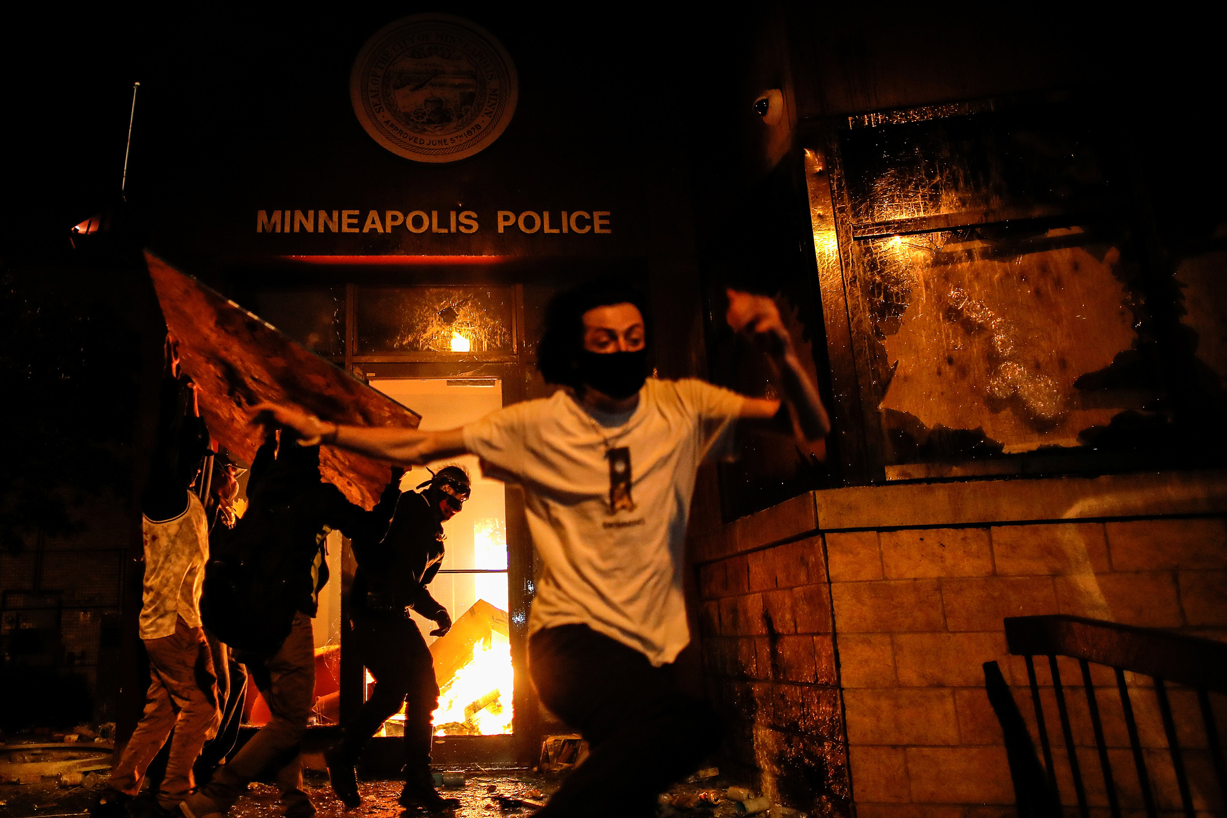
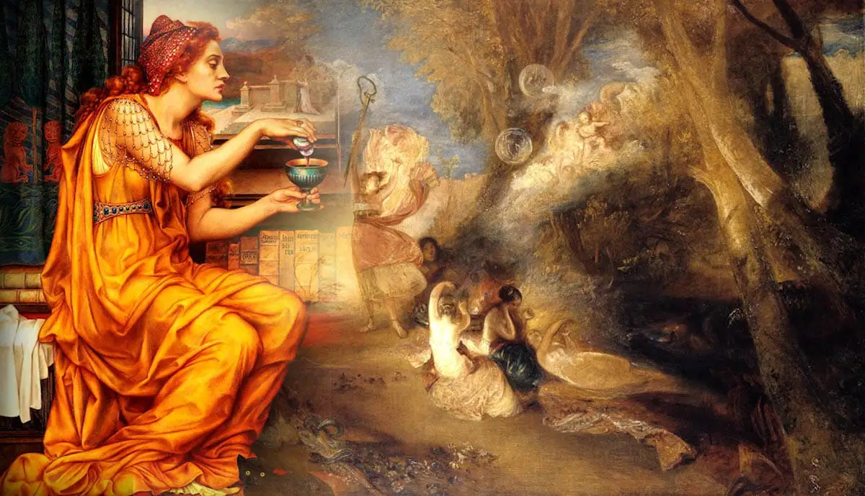
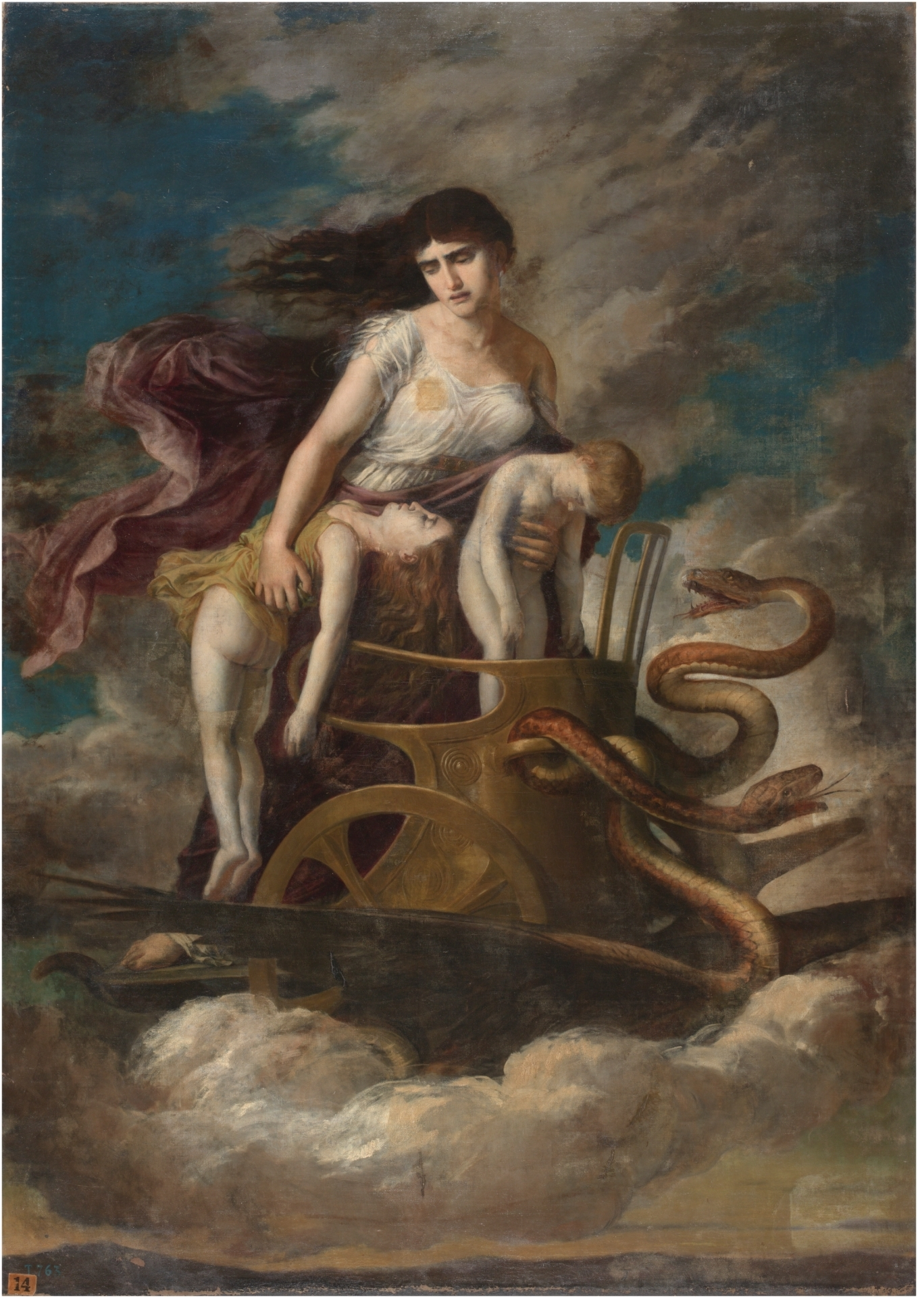
Notes:
Minneapolis riot 2020.
Medeia with a bottle of poison; Medeia with her two dead sons.

Slide 8
I will give you a proper treatment of rage later, but here are some main points
(a possible endresult of phenomenological analysis):
Unlike anger and hatred, rage is
(a) momentary or has a momentary trigger and motivates immediate action and may also motivate acts of violence,
(b) is about experienced general injustice not just unfairness targeted at the subject of experiencing, i.e., its intentional object is or entails an injustice,
(c) can be justified or non-justified (unjust) in resepct to the experienced injustice,
(d) is simply destructive (aims at destroying the injustice or its cause); therefore other emotions are needed for a positive politics and for new beginnings (Arendt’s argument).

Slide 9
The results of the phenomenological analysis of the intentionality of the emotion of rage can then be used to answer ethical and ethico-political philosophical questions about destructive actions and rage:
• Explanation of action by motivation: What are the emotive motivations of the action, is rage involved or other emotions?
• Justification of the action: Is the action justified?
• Justification of the emotion: Is the motivating emotion justified?
• Efficiency and success of the action: Did the action reach its intended goals?

Slide 10
Does rage have a role in this event?
If rage has a role, then what role? Other emotions? Anger, resentment, frustration…?
Notes:
Just Stop Oil protestors throw tomato soup at Vincent van Gogh’s painting Sunflowers (1888) in the national gallery in London in 2022.
The protester on the left states: “What is worth more, art or life? Is it [art] worth more than food, worth more than justice? Are you more concerned about the protection of a painting or the protection of a planet and people? The cost of living crisis is part of the cost of the oil crisis. Fuel is unaffordable to millions of cold, hungry families. They can’t even afford to heat a tin of soup.”
Andy Warhole’s Campell’s Soup Cans (1962). Warhole: “In the future, everyone will be world-famous for 15 minutes.”

Slide 11
If this painting is about beauty,
then does some emotion – happiness,
gratitude, energy – have a role in it,
in its production or reception or its being?
Notes:
Vincent van Gogh’s Sunflowers (1889): “Vincent wanted to combine two versions of the Sunflowers with Woman Rocking the Cradle, the portrait that he made as an homage to the comforting mother figure. Together, the paintings were to form a triptych. The two Sunflowers were the ‘yellow panels’ that would intensify the colours of the portrait. Vincent thought that the triptych as a whole symbolised gratitude.”

Slide 12
Summary of the goals of phenomenological analyses
A. Goals: the explication and clarification of (a) the meaning of the emotion, (b) its general structures, (c) the necessary (and sufficient) conditions for its formation, taken for granted by empirical investigations.
B. Type of Generality: Philosophy aims at exceptionless truth-claims that hold independently of empirical factors, situations, time or place; in addition to investigating actual (present, past, future) cases, it also studies possible ones.
The range of the term “all” (universal quantifier): exceptionless generality.
Compare to
• grammar: Each sentence entails a predicate term and a subject term.
=> any linguistic unit that lacks either one or the other is not a sentence but is something else (e.g., a part of a sentence).
• mathematics: 2 + 2 = 4, the sum of a triangle is 180º
• morality: “Do not kill!”

Slide 13
PHENOMENOLOGY
= intentional analysis of experiences and experienced phenomena,
their intentional and temporal structures,
= a particular philosophical method of analysis.
INTENTIONALITY 1: correlative structure between (A) acts and (B) objects
⬄ Experience is articulated into intending acts and intended objects.
objects are studied as meant, under the activities of sense-making or meaning-constitution.
So, we have two structural features of experiencing: (1) act & (2) object;
technically put: the noesis-noema correlation.
The third structural feature of experience: (C) the subject of experiencing
The self, ego, person to whom phenomena are given and who lives through the experiences.
The subject of experiencing is also called ”the dative of experiencing”*.
So, all in all, we are studying the subject-act-object or ego-act-object or person-experience-object correlation.
Notes:
* This is because the dative in German expresses to whom something is given (the Finnish allative which answers the question “Kenelle?”).

Slide 14
TYPES OF INTENTIONALITY
We can distinguish between three basic types of intentionality:
(i) cognitive (also doxic), (ii) practical (also conative), (iii) axiological
≈ (i) cognition, belief, perception; (ii) volition, deciding; (iii) emotion, valuing.
We can also detect *non-intentional “underlayers” of intentional (targeted) experiencing in (i) sensation; (ii) drive and instinct; (iii) feeling.
Notes:
* The non-intentional underayers of intentionality have been clarified, most importantly, by Bernet, Depraz, Lee, Jansen and Smith:
Bernet, Rudolf 1996: “The unconscious between representation and drive: Freud, Husserl and Schopenhauer,” in Truthful and Good: Essays in the Honor of Robert Sokolowski, Dordrecht, London, Boston: Kluwer, 81–95.
Bernet, Rudolf 2018: Force, Drive, Desire: A Philosophy of Psychoanalysis.
Depraz, Natalie; “Pulsion, instinct, désir: que signifie Trieb chez Husserl,” Alter, vol. 9, 113–125.
Jansen, Julia 2022: “The role of instinct in Husserl’s account of reason,” in Contemporary Phenomenologies of Normativity: Norms, Goals, Values, eds. Sara Heinämaa, Ilpo Hirvonen, and Mirja Hartimo, London: Routledge.
Smith, Nicolas 2010: Towards Phenomenology of Repression – a Husserlian Reply to the Freudian Challenge, Acta Universitatis Stockholmsiensis, University of Stockholm.
Lee, Nam-In 1993: Edmund Husserl's Phänomenologie der Instinkte, Dordrecth: Springer.

Slide 15
SUMMARY OF TYPES OF INTENTIONALITY
Name of the Type of Intention | Cognitive (also doxic) | Practical (also conative) | Axiological
Paradigmatic Examples | belief, knowledge | volition, decision, willing | emotion and valuation
Non-Intentional Underlayer | sensations (of qualities) | drives and instincts | feelings (of value)
Notice: One and same sensations may serve as the ground for two different cognitive intendings, e.g., sensory perception and belief, but many concrete experiences entail and combine all types of intendings into a complex synthetic whole.

Slide 16
INTENTIONAL ELEMENTS OF EMOTIONS
The experiential content of the emotion entails:
• the target, the focal object of the emotion
≈ the focus of the experience, at the center of consciousness
the “aboutness”, the intentional object of the experience
• other aspects of the experience: while being focused at an object, the experiencing subject may, at the same time, be conscious of other matters, such as
duration (temporality)
experienced changes in their own body (e.g., blushing) (embodiment)
background / situational conditions
these other aspects are called “marginal” (William James & pragmatism) or “horizontal” (Husserl & phenomenology)
• the motivation and origin of the emotion.
Bodily aspects may be
(A) experienced: expression, behavior, action… (e.g., tension, posture, facial expressions, sounds)
(B) theoretically discovered and non-experienced: physiological, neural… (heartbeat, blood pressure, hormonal changes).

Slide 17
Noticing a friend in rock concert
Type of experience: perceptive (main type) + emotions of surprise and joy (adjuncts)
Focal object: friend,
Duration: relatively short,
Marginal/horizontal co-inteded objects: the band (visual), music (auditory), the stage, the audience, the music hall…,
Bodily aspects: movements of sense-organs (experienced?),
Motivation: hearing someone call our name.
Happiness about friendship after a common hiking trip
Type of experience: emotional (happiness),
Focal object: friendship,
Duration: relatively long,
Marginal/horizontal co-intended objects: memorized and imagined friends,
Bodily aspects: possibly posture of the body,
Motivation: ?
Being attracted by a stranger
Type of experience: emotional (main type) + perception, recollection and imagination (manners of having the person given in experience),
Focal object: an unknown person,
Duration: may also be long, may return as a recollection throughout one’s whole life,
Marginal/horizontal co-intended objects: associations to other people given by recollection,
Bodily aspects: strong bodily feelings and sensations,
Motivation: unknown, or association to loved ones and lovers.
Disgust after the event of witnessing a lethal car accident
Type of experience: emotional (disgust),
Focal object: the mutilated bodies of the victims,
Dudation: variant (e.g. short but may return or re-emerge later),
Marginal/horizontal co-intended objects: the car, the road, the other bystanders, the ambulance… memorized earlier tramatic events,
Bodily aspects: strong bodily feelings and sensations,
Motivation: ?

Slide 18
Conative intentionality: Three examples of phenomenological results
“Let us think of willing that is aware of its goal and has an effect or operates in successful action. It is unthinkable that here, at the moment of attainement, the pleasure of realization is missing” (Husserl Hua37, 66).
• Result1: The success of volitional and goal-directed action necessarily entails pleasure of some sort.
“The goal is what one values and that for which one strives [in action]; it is certainly not the valuing, neither the valuing in a presentation nor the saturated valuing in the form of joy of the goal” (Hua37, 86, italics added).
• Result2: What is valued in action is the goal of the action and not any experience (act) of pleasure.
=> Argument against hedonism that claims that we strive and can only strive for pleasure.
Notes:
Hua37: Einleitung in die Ethik, Vorlesungen über Sommersemester 1920/1924, Husserliana XXXVII, ed. Henning Peucker. Dordrecht: Springer. Forthcoming in English.

Slide 19
“Striving, like thinking and like every egoic act in general, is an ‘intentional’ experience [Erlebnis, elämys]. Its ineluctable essene is an intention for something; it means something, countains a sense [noema] that can be brought to clarity. (…) When studying intentional experiences [Erlebnisse], the phenomenological method always proceeds by questioning these experiences themselves, both about what they are in themselves [acts, noeses] and what they mean [noemata]. Leaving aside everything that is accidental, adhering to what is necessary, so in our investigation that without which striving as such would be unthinkable. Here belongs a certain structure [Aufbau] of stiving, accoring to which it is necessarily grounded upon a valuing or holding of value of that for which one strives. On the side of the sense [noema], (…) the goal is necessarily characterized in the striving consciousness as value” (Husserl Hua37, 85).
• Result3: All inquiries into stiriving and action necessarily depends on theory of value, and in so far as values are disclosed in emotion also theory of emotion.

