Slide 1
“Political” Emotions: 3 Phenomenology (cont.), Aversive Emotions (Kolnai)
Sara Heinämaa
University of Jyväskylä

Slide 2
Content
I Phenomenology: References, technical terms and exemplary results
II Kolnai on aversive emotions: Fear, hatred, disgust

Slide 3
Empathy and its bodily conditions (Pauliina’s question)
Heinämaa, Sara 2021: “On the transcendental undercurrents of phenomenology: The case of the living body,” Continental Philosophy Review, Special issue on Methods, eds. Steven Crowell and Anthony Fernandez, vol. 54, no. 2, 2021, 237–257, https://link.springer.com/article/10.1007/s11007-021-09534-z
Luo, Zhida 2017: Motivating empathy: The problem of bodily similarity in Husserl’s theory of empathy,” Husserl Studies, vol. 33, no. 1, 45–61, https://www.academia.edu/22784147/Motivating_Empathy_The_Problem_of_Bodily_Similarity_in_Husserls_Theory_of_Empathy
Husserl, Edmund Hua1: Cartesianische Meditationen und Pariser Vorträge, Husserliana I, ed. Stephan Strasser, The Hague: Martinus Nijhoff, 1950. In English: Cartesian Meditations, trans. Dorion Cairns, The Hague: Martinus Nijhoff, 1960.
Stein, Edith [1917] 1989: On the Problem of Empathy, trans. Waltraud Stein, Collected Works of Edith Stein, Sister Teresa Benedicta of the Cross Discalced Carmelite, Volume Three, 3rd revised edition, Washington: ICS Publications. Original Zum Problem der Einfühlung 1917.
Svenaeus, Fredrik 2018: “Edit Stein’s phenomenology of sensual and emotive empathy,” Phenomenology and the Cognitive Sciences, vol. 17, 741–760, https://www.researchgate.net/publication/323709201_Edith_Stein%27s_Encounter_with_Edmund_Husserl_and_Her_Phenomenology_of_the_Person
Szanto, Thomas and Dermot Moran: “Edith Stein,” Stanford Encyclopedia of Philosophy, ed. Edward N. Zalta, URL = <https://plato.stanford.edu/archives/spr2020/entries/stein/>

Slide 4
“Empathy (…) is the experience of foreign consciousness in general, irrespectively of the kind of the experiencing subject or of the subject whose consciousness is experienced” (Stein 1917, 10/11).
“If we stick to the factical, i.e., to the experience of someone else as it comes to pass at any time, we find that actually the sensuous seen body is experienced forthwith as the body of someone else and not as merely an indication of someone else (…) What I actually see is not a sign (…); on the contrary, it is someone else” (Husserl Hua1, 150–153/121–124).
“The lived body of another continues to prove itself as actually a lived body, solely in its changing but incessantly harmonious behavior. Such harmonious behavior (…) must present itself fulfillingly in originary experience [perception] and do so throughout the continuous change in behavior from phase to phase. The organism becomes experienced as a pseudo-organism precisely if there is something discordant about its behavior” (Husserl Hua1, 144/114).

Slide 5
Tehchnical terminology (Nina’s question)
Experience is studied in phenomenology as an intentional relating to an object, => object is studied as it is intended, that is, under the sense in which it is intended (by the subject).
We are influenced by numerous objects that do not figure in our conscious experience, e.g., current circumstances, existing things, occuring events and unconscious inclinations (drives, instincts).
Only the ones that enter our consciousness (either focally or horizontally) are parts of our conscious experience and only such conscious influences motivate us and can be studied by phenomenological methods.
Examples of non-intended influences:
E1 You enter an elevator with a friend in a department store discussing your common hiking trip; when you exit the elevator you are humming a tune; your friend says “It catchy”; you realize that the tune was playing in the elevator.
E2 You fall in love with a person whom you have just recently met. The person happens to be cross-eyed. You go to wisit your mother who shows you some old photos. In one of the photos you are standing hand in hand with another child. Your mother says: “There you are with your first sweethearth”. You look at the photo and realize that also your childhood beloved was cross-eyed (case reported by Descartes in his Passions of the Soul 1641).
“What I do not ‘know ‘, what does not stand over against me in my lived experiences, in my representing, thinking and acting, as the represented, perceived, remembered, thought, etc., does not ‘determine’ me mentally or spiritually” (Husserl Hua4, 231/243).
Notes:
*In his pre-phenomenological work Logical Investigations (origninal publ. 1900), Husserl used the technical terms “act-quality” and “act-matter” to analyse intentional experiences. In his fully phenomenological work Ideen toward a Pure Phenomenology and Phenomenological Philosophy I–III (original publ. 1913), he introduced the technical terms “ego”, “noesis” and “noema” for the same purpose.
Original titles: Logische Untersuchungen (1900); Ideen xxx I (1913).

Slide 6
“Parts” of experience, called its “moments”
We can distinguish between three structural parts or moments of intentional experience:
1. the manner or act of intending = noesis
2. the object as intended = noema ≈ sense,
3. subject of intentional acting: ego, person.
These are not separable parts but are mutually dependet moments that can only be distinguised by conceptual analysis,
cf. the two sides of a coin or the four parts of a river – the source, the stream, the bank and the estuary – which cannot be separated but can only be distinguished conceptually.
So, the main targets of phenomenological analyses are the ego-noesis-noema* structures of experiences and the intentional relations that they entail: someone intending something as something.
EXAMPLES:
Sexists intending women as lower creatures without full human capacities of delibreation and reasoning.
An operating surgeon intending her/his patient as a bio-chemical mechanism, and a nurse intending the same patient after the operation as a emotional agent.
Central-European colonialists intending the people of the colonialised countries as work force.
In rage, Medeia intending her husband as the source of unjustice and destruction, and her sons as tools of punishment.
Our main task is to describe such structures of intending, not to judge the persons involved.

Slide 7
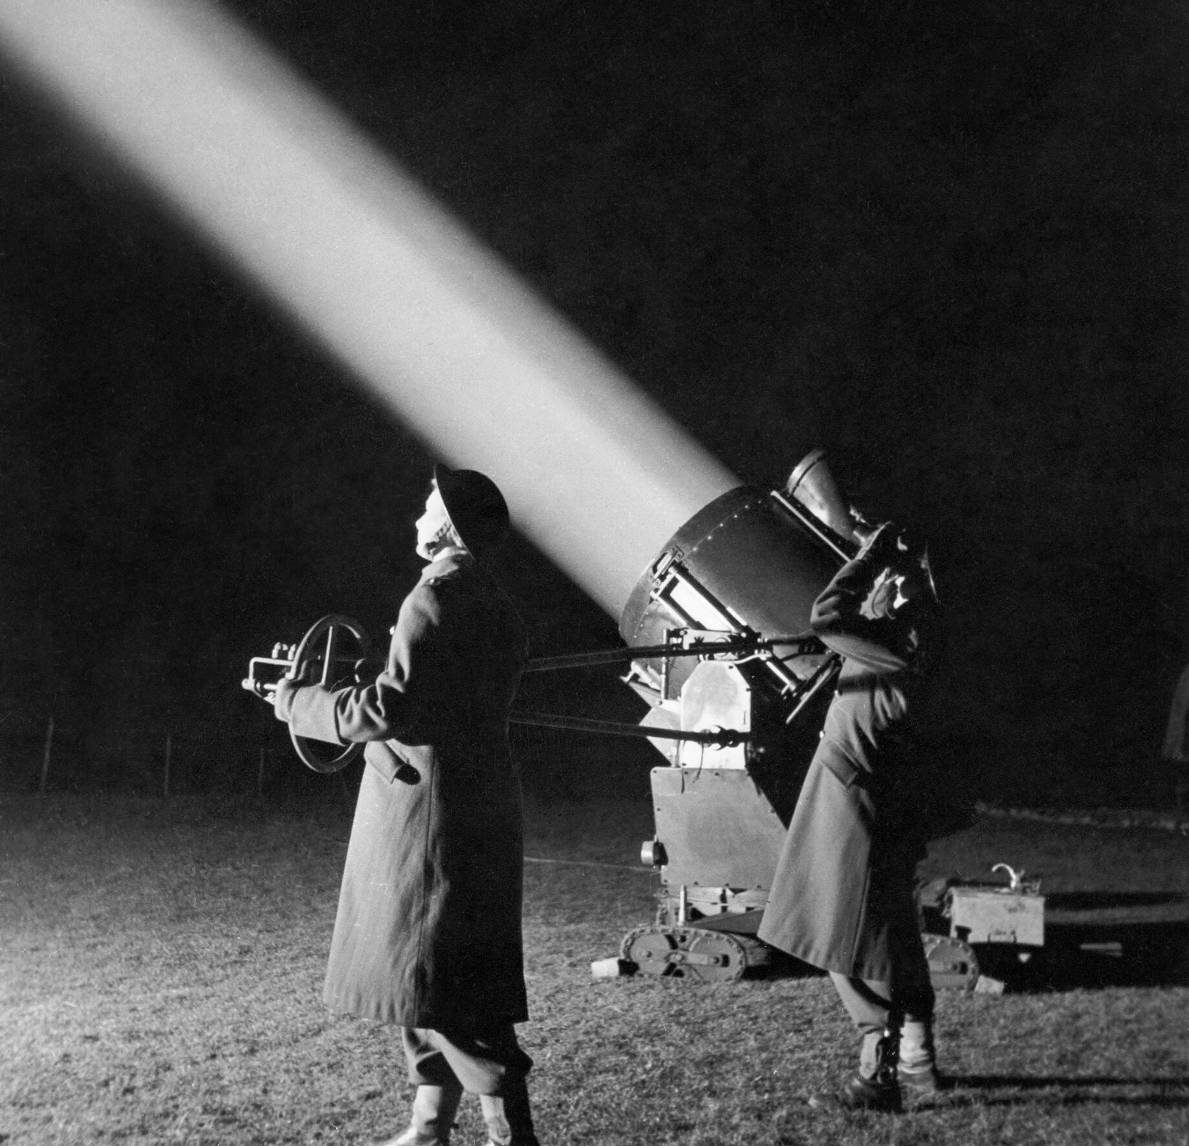
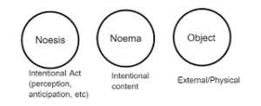
Metaphors used to picture the ego-noesis-noema structure: The search light metaphor (in Finnish “valonheittäjä”, “taskulappu”): Basic idea: Egoic consicousness throws light on its intentional objects

Slide 8
The subject
The subject of intentional acts (experiencing) can be human but also non-human (e.g., an animal, or an extraterrestrial agent, a divinity, an artefact, e.g. AI?).
It can individual but also collective.
Exampes of collective subjects: the grieving parents; the raging croud on the street; the members of the parliament establishing a new law; an bunch of people occasionally cathering around crashed cars.
The subject of experiencing is also called “the dative of experiencing”.
This term derives from the German case dative that allows us to express to whom something is given (≈ the Finnish case allative that answers the question to/for whom: “Kenelle?”). The idea here is that something (the object) is given to and appears to someone (the subject).
So a central universal exceptionless claim by phenomenologists is that each experience necessarily involves an experiencing subject to whom something is given.
=> Can you think of counter examples? Are there experiences without subjects?
Candidates: unconscious drives; dispersed or anonymous orinatations that do not belong to anyone, not to any subject, human or non-human, individual or collective; operations of bureaucratic or total power…?

Slide 9
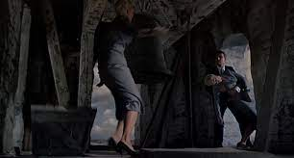
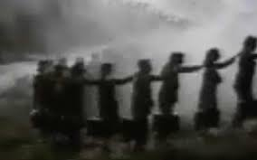
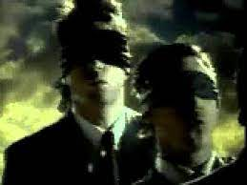
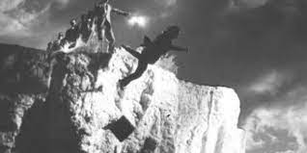
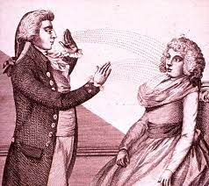
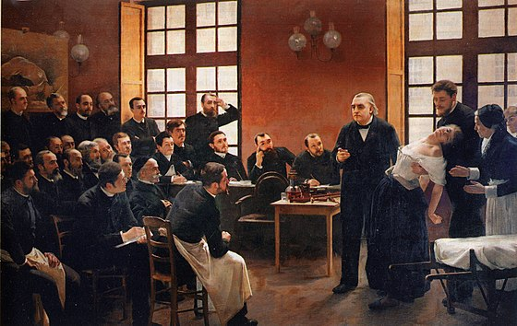
Notes:
Top: Three scenes from Alfred Hichcock’s Vertigo (1958): pictures a man who is directed by his unconscious traumas and his fear of hight which only partly enter his consciousness and mainly stays in darkness.
Middle: Apple’s ”Lemmings commersial” that lounched The Maccintosh Office in 1985: pictures people who are directed and guided to destruction by ideas that are “put in their minds” and do not properly belong to them.
Down: Pierre Aristide André Brouillet’s painting A Clinical Lesson (1887) that pictures the famous neurologist Jean-Martin Charcot delivering a clinical lecture and demonstrating hypnosis on a hysterical patient named Marie “Blance” Wittmann in Paris: the possibility of hypnosis shows that others “can put contents (beliefs and emotions) in our minds” or draw them out from our subconsciousness.

Slide 10
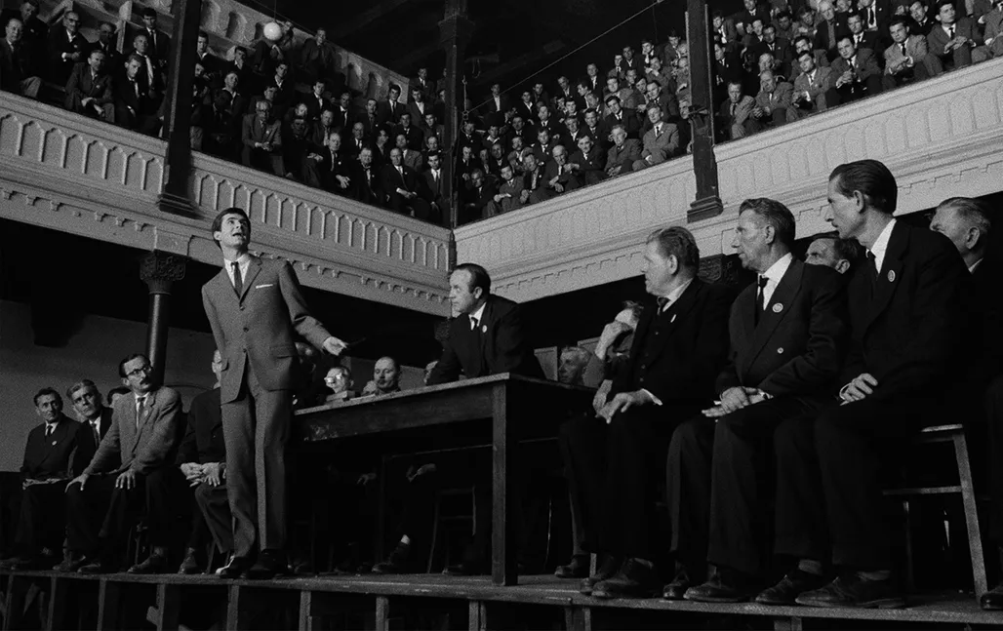
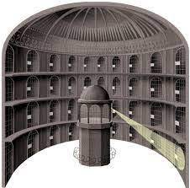
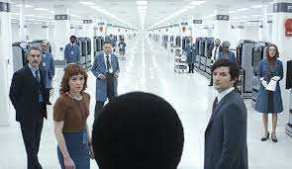
Notes:
Top: Thee scenes from Orson Welles’ filmatization (1962) of Franz Kafka’s The Trial (Der Prozeß 1915–1915, 1925): pictures men who is surrounded and guided by an anonymous and dispersed power without realizing the situation.
Down: Two scenes from TV series Severance by Ben Stiller and Dan Erickson (2022); a drawing of the Panopticum which is a spatial structure designed for control; discussed by Michel Foucault in Discipline and Punish: The Birth of the Prison (Surveiller et punir: naissance de la prison 1975).

Slide 11
Does all experience entail a subject to whom something is given (the dative of experiencing)?
Hyponosis, mental manipulation and paranoic experiences of being monitored and/or manipulated by anonymous agencies may seem to undermine the general phenomenological claim that all experience entails a subject to whom something determinate appears or is given (the dative of experiencing).
Two possible lines of arguing against this claim:
Hyponosis and mental manipulation do not question the main phenomenological thesis. They merely show that we must not assume that the experiencing subject is the same as the agent who controls or initiates the experiences.
The panopticum experience does not question the main claim either. It suggests, however, that we must allow for the possibility that the agency that initiates our emotional experiences is distributed in things and spatial organization of things.
So, the subject, the dative of experiencing is neither the producer nor the controller of the experience; s/he does not decide what senses (noemata) are given and how they appear to her/him. S/he merely undergoes the experiences and captures or articulates sense.
Cf. Thomas Nagel: “What is it like to be a bat?” (1970).
Notes:
Nagel characterized consciousness and experience by the phrase “to-be-like” as follows: ”[T]he fact that an organism has conscious experience at all means, basically, that there is something it is like to be that organism.” Nagel called this like-quality as ”the subjective character of experience” (Thomas Nagel, “What is it like to be a bat?” The Philosophical Review, vol. 83, no. 4, 435–450). Nagel’s proposal has initiated dominant discussions in 20th and 21st century analytical philosophy of mind on the phenomenality and qualia of awareness, consciousness and conscious experience. Notice that Nagel’s formulation is quasi-ontological, the term “to-be-like” refers to the quality or manner of being.

Slide 12
We can distinguish between three main types of intentional acts:
(i) Doxic (also cognitive), (ii) axiological and (iii) conative (also practical). More precisely,
(i) Doxic acts intend various forms of being: existents, states of affairs, matters of facts, realities; they come in many different kinds, e.g., beliving, presumption, knowledge…
(ii) Axiological acts of feeling intend values, and they too can be of different kinds, e.g., emotional attention, valuation, evaluation…
(iii) Conative acts of willing itend goals, and they too have their different kinds: choices, decisions, commitments, realizing actions, which all involve willing.
E.g. A young child sees an icecream kiosk; s/he notices the beautiful radiant color of orange icecream; s/he desires and wills it and starts crying when she is given brown chocolate icecream instead.
E.g. A researcher learns that the library entails a rare copy of Edith Stein’s manuscripts; s/he decides to study these texts; in the library, she is told that the manuscripts are under digitalization and cannot be studied at the moment; she feels very disappointed of not getting access to these important sources.
All acts and manners of experincing have passive non-intentional sublayers. The passive sublayers of doxic acts are in sensations, those of axiological acts are in non-intentional feelings, and those of conative acts are in drives and inclinations (e.g., insticts and habits).
The subject of conative experiences – volitions, choices, decisions, resolutions, actions – is also called the agent.

Slide 13
Kolnai’s arguments and analyses
In the paper “The standard modes of aversion: Fear, disgust and hatred” published in 1998 in Mind:
1. a general argument about emotions: negative and positive,
2. specific analyses of three negative emotions, three aversions: fear, hatred, and disgust.
Kolnai had already presented a more extensive and deeper analysis of disgust in an earlier paper “On disgust” (original “Der Ekel” 1929).
This early paper is highly influential: it has influenced many later philosopical discussions on disgust (Sartre, contemporary, e.g. McGin, Strohminger, Korsmeyer) but it also influenced many visual artists who studied disgust (Dali and Bunuel) and, via a detour, anthropologists (Mary Douglas), semioticians and psychoanalysts (Julia Kristeva).
Notes:
Kolnai, Aurel 1929: “Der Ekel,” Jahrbuch für Philosophie und phänomenologische Forschung, vol. X, 515–569.
Korsmeyer, Carolyn 2020: “Philosophical perspectives on disgust and repulsion,” Emotionen, eds. Hermann Kappelhoff, Jan-Hendrik Bakels, Hauke Lehmann and Christina Schmit, Dordrecht: Springer, 160–164.
Strohminger, Nina 2014a: “Disgust talked about,” Philosophy Compass, vol. 9, no. 7, 478–493.
Strohminger, Nina 2014b: “The meaning of disgust: A refutation,” Emotion Review, vol. 6, no. 3, 214–216.
McGin, Colin 2014: The Meaning of Disgust, Oxford: Oxford University Press.

Slide 14
Salvador Dali’s The Accomondations of Desire (Les accommondations des désirs 1929)
Dali’s and Louis Bunuel’s An Andalusian Dog (Un chien andalou 1929)
Notes:
Top:
Salvador Dali’s paintings and writings:
1929: The Accomondations of Desire (Les accommondations des désirs).
[1930] 1979: “L’âne pourri,” in Dali: Retrospective, 1920–1980, exhibition catalogue, Centre Georges Pompidou, Paris.
1932: “The object as revealed in surrealist experiments,” This Quarter, vol. VIII, no. 1.
The film An Andalusian Dog by Dali and Louis Bunuel (Un chien andalou 1929).
Down:
Jean-Paul Sartre’s discussion of the slimy in Being and Nothingness: A Phenomenological Essay on Ontology (L'être et le néant: essai d'ontologie phénoménologique 1943)
Mary Douglas’s discussion of the slimy in her anthropological classic Purity and Danger: An Analysis of the Concepts of Pollution and Taboo (1966).
Salvador Dali’s 50 Secrets of Magic Craftmanship (1948) in which he desribes the research interests involved in and motivating his paining.
Julia Kristeva’s conceptualization of the abject in her Powers of Horror (Pouvoirs de l’horreur: un essai sur l’abjection 1982), and her Black Sun (Soleil noir 1989).

Slide 15
Kolnai’s general argument against the symmetry assumption
The symmetry assumption: The idea that negative and positive emotions would correlate and form symmetrically contrasting (oppositional) pairs without residues:
love / hatred
pro / con… acceptance / rejection
liking / disliking… attraction / repulsion
pleasure / pain
Kolnai: This is a mistaken and groundless assumption (1998, 581).
=> Emotions do not form a pair of opposites; in particular, hatred and love do not form such pairs.
SH: Such oppositional and dichotomous accounts of emotions are not based on the analysis of emotions but are borrowed from elsewhere, either from theory of judgment and/or from theory of sensation.
In logic and theory of judgment, we can oppose affirmative and negative judgments (without any significant residue), and in theory of sensation, we can similarly oppose pleasant and unpleasant sensations, pleasure and pain. In the case of emotions, Kolnai argues, similar distinctions cannot be made without violating experience. So, the dichotomous dualistic framework is alien to the experiential field of emotions and belongs to other fields.

Slide 16
Kolnai’s four arguments against symmetry
1. Conceptualization: While different negative emotions can be distinguished from one another by determinate concepts – such as anger, hatred, fear, anxiety –, positive emotions are usually distinguished by specifying attributes.
We distinguish, for example, between erotic love, romantic love, brotherly love, neighborly love and diving love; we distinguish between hilarious, cynic and ecstatic joy, between eudaemonic (experiences of meaning and purpose) and hedonic happiness (experiences of pleasure).
=> 2. Typification: Negative emotions allow more of abstract typifications than positive emotions.
In case of positive emotions, we cannot abstract (easily) from the specificity of the object and from the corresponding activity of the experiencing subject:
“[A] far higher degree of abstract typological characterization is possible on the negative or aversive side” (Kolnai 1998, 593).
3. Unity/variance: Our relations to the objects of our negative emotions are less specific and more generic (Kolnai more “distant”) than our relations to/with the objects of our positive emotions. Correspondingly, the acts of negative emotions have a standard form while those of positive emotive acts are highly variant.
Simply, we are able to love more concretely and in more detail and variance than we are able to fear and hate.

Slide 17
Kolnai’s four arguments (cont.)
3. Unity/variance
In Kolnai’s own words: “[O]ur positive contacts, our consonances and our endeavors of union and communion with objects are functional”; “their respective nature [is] closely adapted to the manifoldness of actual and possible objects and of the kinds of activity they invite or lend themselves to” (Kolnai 1998, 593, italics added).
=> The plurality of positive emotions reflects the richness of the world and its objects.
⬄ The conceptualization of positive emotions is necessarily more multidimensional and less linear than that of negative emotions (Kolnai 1998, 594).
“Any project of attempting an analogous [typifying] description of the modes of attraction would tempt us into describing life itself” (1998, 594).
4. Standard behavior: No standard types of actions can be named in case of the positive emotions, but we can easily name paradigmatic types of actions and behaviors in case of the negative ones:
e.g., fear & flight; hatred & controlled annihilation (killing); anger & revenge; rage & “blind” destruction; disgust & rejection… (Kolnai 1998, 594).
“No schema comparable to the triad flight, repugnance (…) destruction (…), even with the conceivable addition of a few more, similarly abstract and formal modes, could be applied to the inexhaustible world of our pro attitudes and love-like attention” (Kolnai 1998, 594).
Love, for example, can be expressed and realized in manifold behaviors and actions.

Slide 18
Summary
• Kolnai’s three-fold (triad) distinction between aversive emotions: fear, disgust, hatred (1998, 594): given in terms of their intentional objects, manners of relating (intentional acts) and respective manners of behaving (expressions).
• Kolnai’s non-correlation thesis: “I shall argue that no such fundamental division, that is, none exactly on the same logical footing with this, can be attempted in the vastly more variegated range of friendly responses [or presentations 582]” (1998, 581).

Slide 19
Three aversive emotions: Hatred Fear Disgust
Jesus cleansing the temple from buyers and sellers A young boy shuddering in fear for a poisonous lizard A woman convulsing in nausea
Notes:
Bernardo Mei’s Cleansing of the Temple (1655).
Garavaggio’s Boy Bitten by a (Poisonous) Lizard (1593–1954).
From Ruben Östlund’s movie Triangle of Sadness (2022).

Slide 20
A contrasting side remark about love
Love has multiple variants, and the concept of love covers a broad variety of different manners of intending the beloved. These can be and are usually distinguished by specifications (adjectival attributes).
“In every language, the word ‘love’ has a way of embracing the entire conceptual field of pro responses: (….). Hatred is confined within much narrower limits: its proper object is only s person or collective of persons” (Kolnai 1998, 581).
We can easily distinguish by specifications between, for example, erotic love, romantic love, affective ties between family members and partners, loving friendship, self-love, and the brotherly, sisterly and neighborly love that arguably unites all human beings, and vocational love directed at personally significant goals, e.g., the flourishing of a child, the success of a sport or work team, the good of the humankind, the values of Truth, Beauty.
Certain forms of love also entail a conative factor, an act of will by which the lover commits her/himself to the beloved. The idea of such love is reflected in the wedding ceremony in which the pastor asks:
”Before the eyes of the almighty God and in the presence of this assembly I ask you, NN, will you take MM to be your wedded wife/husband and to show her/him faithfulness and love in need and in plenty, in sorrow and in joy?”
Husserl argues that all “genuine love” entails a deeply personal conative factor, i.e. an act of will; so, not just spousal or religious forms of love entail such a factor but also love between friends, parents and children, and also love directed at the Good, Beauty and Truth.
The idea here is that due to its conative element (volition, decision) such love is resistant to external and internal changes and thus pervading. Husserl argues that such loving is possible for human beings and is an ideal toward which they should strive.
Notes:
The declaration of the civil wedding reads: “I call upon these persons here present to witness that I, NN do take you, MM to be my lawful wedded (wife/husband/spouse/partner). I will trust you and respect you, laugh with you and cry with you, loving you faithfully through good times and bad. I give you my hand, my heart and my love, from this day forward for as long as we both shall live.”

Slide 21
Philosophers, both phenomenological and classical, have developed concepts to capture such experiential differences:
Nikolai Hartmann (four types): brotherly love (agape); love of the remote ideal (eros); love of the radiant virtue of an exemplary individual; personal love in depth (Ethik 1926).
Thomas Aquinas (three types): amor dilectio: chosen, will-based; amor caritas: perfect(ed); amor amicitia: habitual, habituated.
Aurel Kolnai: “the traditional trinity”: contemplative love (amor contemplacentiae); desiring, desire-motivating, lustful love (amor concupiscentiae) takes pleasure in the beloved’s goodness; benevolent love (amor benevolentiae);
and additional manners of loving: loving for pleasure, that is for something else than for the beloved (amor complacentia); loving for the sake of the beloved one (amor amicitae).
Hanna Arendt: fundamental love of the world (amor mundi).
Naming of kinds of love:
contemplative (amor contemplacentiae), e.g., for God, Nature, Beauty,
desiring, desire-motivating: lustful (amor concupiscentiae),
benevolent (amor benevolentiae),
amor dilectio: chosen: will-based,
amor caritas: perfect(ed): universal neighbourly love in Christianity
amor amicitia: habitual, habituated,
erotic carnal (eros) (Plato’s Symposium)
playful free (ludus),
committed, long-term (pragma),
character-based (mutual, highest) (philia) (Aristotle’s Nicomachian Ethics)
familial (natural, instinctual) (storge),
self-love (philautia),
charitable (agape): highest, God’s love for humans.

Slide 22
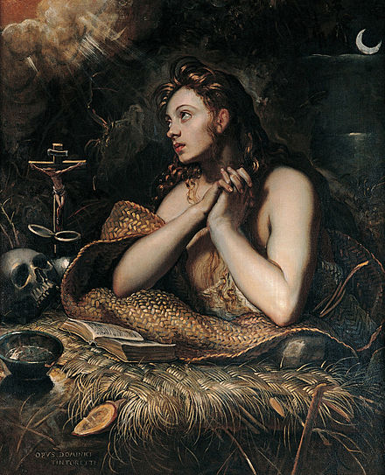
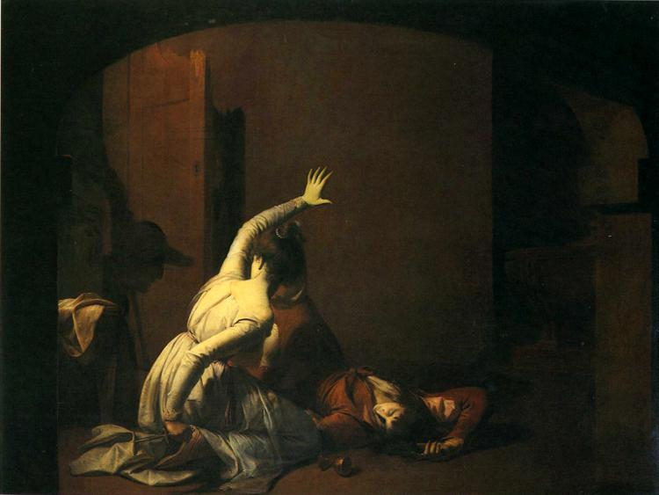
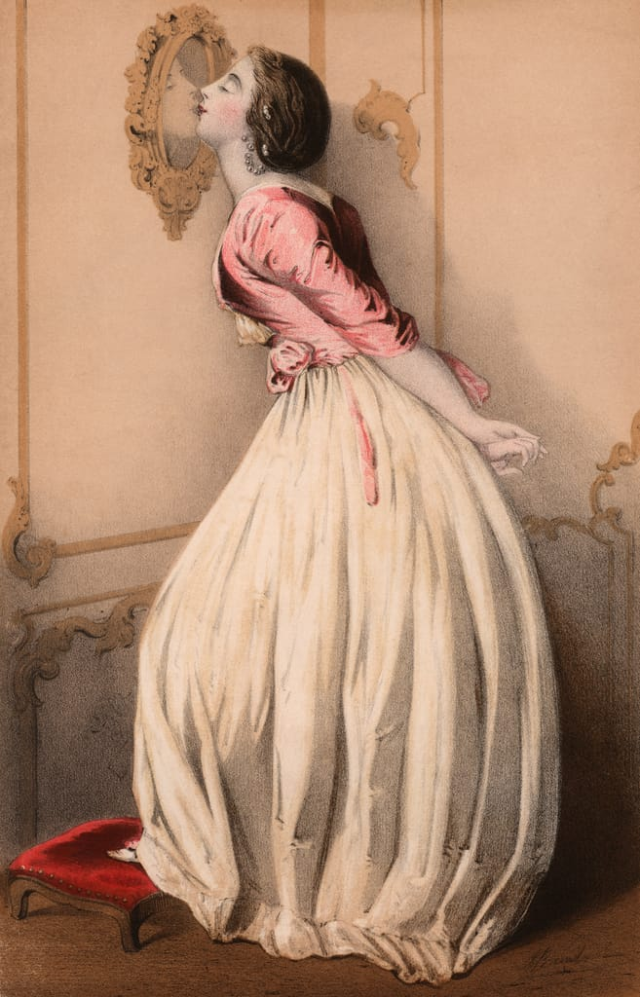
Variations of love: love of God, love of nation, parental love, romantic and tragic love, self-love, erotic love
Notes:
Top: Resurrected Jesus and Maria Magdalene in the fresco Noli Me Tangere by Fra Angelico from 1440s.
Mary Magdalene by Tintoretto (1598).
Patriotism in French-German war.
Middle:
The film Sophie’s Choice (1982) by Alan J. Pakula, on the basis of William Styron’s novel by the same title (1979).
Down:
Jospeh Wright of Derby’s painting of Julia and Romeo (1790–1791).
Schönes Mädhchen küsst ihre Reflexion im Spiegel.
Sappho and Erinna in the Garden Mytilene (1864) by Simeon Solomon.

Slide 23
An initial comparison between the objects of hatred, fear and disgust
HATRED
• basic intentional object: persons: a person or a collective or persons or something expressive of the attitudes or words of persons (581),
• when the object of the emotion is not a person, other concepts and terms are more adequate to describe the emotion: loathing, detestation, repugnance,
• is not a “counter-emotion” of love: “I love the ducks in the park; I would refuse to say that I ‘hate’ the seagulls which infest it in the wintertime” (Kolnai 1998, 581).
DISGUST
• basic intentional object: living beings (organisms) and bodies or their remains, products, vestiges or representations (1998, 581),
• has no positive counterpart whatsoever (1998, 581).
FEAR
• basic intentional object: something harmful or threating; highly variant, from physical to mental, from real to imaginary (e.g., ghosts),
• has no one positive counterpart but several different ones: trust, gratitude, feeling of safety, feeling of tranquility, source of encouragement which various counterparts which counter-emotions…
…are intentionally various: only trust (or gratitude) is necessarily directed at a well-defined intentional object,
…each of which may function as a positive counterpart of fear but only in specific situations:
“What is common to this bunch of ‘opposites’ is precisely only the absence of fear and nothing as definite and sharply profiled as fear” (1998, 582).

Slide 24
Primary and secondary sources (on empathy and disgust)
Heinämaa, Sara 2021: “On the transcendental undercurrents of phenomenology: The case of the living body,” Continental Philosophy Review, Special issue on Methods, eds. Steven Crowell and Anthony Fernandez, vol. 54, no. 2, 2021, 237–257, https://link.springer.com/article/10.1007/s11007-021-09534-z
Husserl, Edmund Hua1: Cartesianische Meditationen und Pariser Vorträge, Husserliana I, ed. Stephan Strasser, The Hague: Martinus Nijhoff, 1950. In English: Cartesian Meditations, trans. Dorion Cairns, The Hague: Martinus Nijhoff, 1960.
Kolnai, Aurel 1929: “Der Ekel,” Jahrbuch für Philosophie und phänomenologische Forschung, vol. X, 515–569.
Korsmeyer, Carolyn 2020: “Philosophical perspectives on disgust and repulsion,” Emotionen, eds. Hermann Kappelhoff, Jan-Hendrik Bakels, Hauke Lehmann and Christina Schmit, Dordrecht: Springer, 160–164.
Luo, Zhida 2017: Motivating empathy: The problem of bodily similarity in Husserl’s theory of empathy,” Husserl Studies, vol. 33, no. 1, 45–61, https://www.academia.edu/22784147/Motivating_Empathy_The_Problem_of_Bodily_Similarity_in_Husserls_Theory_of_Empathy
McGin, Colin 2014: The Meaning of Disgust, Oxford: Oxford University Press.
Stein, Edith [1917] 1989: On the Problem of Empathy, trans. Waltraud Stein, Collected Works of Edith Stein, Sister Teresa Benedicta of the Cross Discalced Carmelite, Volume Three, 3rd revised edition, Washington: ICS Publications. Original Zum Problem der Einfühlung 1917.
Strohminger, Nina 2014a: “Disgust talked about,” Philosophy Compass, vol. 9, no. 7, 478–493.
Strohminger, Nina 2014b: “The meaning of disgust: A refutation,” Emotion Review, vol. 6, no. 3, 214–216.
Svenaeus, Fredrik 2018: “Edit Stein’s phenomenology of sensual and emotive empathy,” Phenomenology and the Cognitive Sciences, vol. 17, 741–760, https://www.researchgate.net/publication/323709201_Edith_Stein%27s_Encounter_with_Edmund_Husserl_and_Her_Phenomenology_of_the_Person
Szanto, Thomas and Dermot Moran: “Edith Stein,” Stanford Encyclopedia of Philosophy, ed. Edward N. Zalta, URL = <https://plato.stanford.edu/archives/spr2020/entries/stein/>.

