Slide 1
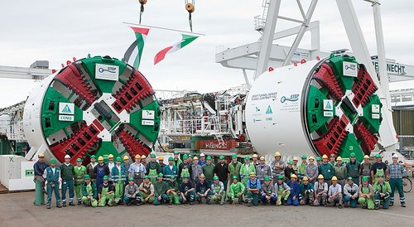
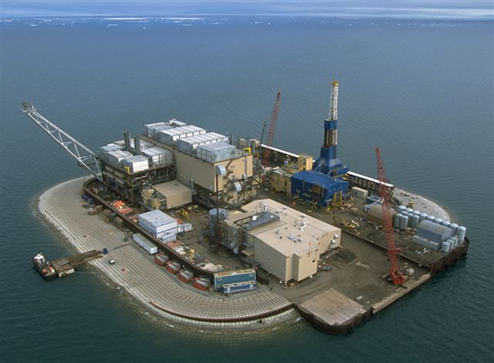
Reinventing organizational careers
University of Jyvaskyla, September 24th, 2014
Case study

Slide 2
Learning objectives
Understand relationships among perceptions of career development opportunity, employee commitment, and employee retention;
Evaluate the pros and cons of «promotion from within» versus «hiring from the outside» strategies;
Integrate the effects of corporate culture, structure, and growth with career development and employee motivation, commitment, and retention;

Slide 3
What will we do?
Diagnose the current situation;
Distinguish between general problems, concrete manifestations and their causes;
Elaborate potential solving strategies.

Slide 4
Assignment questions
What is the general problem in this case?
What are its symptoms (concrete manifestations)?
What are the causes of such symptoms?
What should Walstrom do to address these problems?
Please, create groups of 4-5 students…
Notes:
Dare 15 minuti per dare una prima risposta a queste domande in gruppo
La slide successiva contiene la risposta alla prima domanda

Slide 5
The main problem is…
career development and career paths in CH2M Hill have been neglected since the mid 1990s when the company began hiring new blood at high levels and acquiring new business in support of a change in its business strategy;
In your opinion, what are its two main manifestations or symptoms?
Notes:
Dare del tempo per rispondere e motivare

Slide 6
The two main symptoms are…
Unacceptably high voluntary turnover among new employees;
Few or no qualified internal candidates for higher level leadership positions;
In your opinion, what are the causes of this unacceptably high turnover rate?
Notes:
Dare 15 minuti per trovare una risposta articolata

Slide 7
The reasons for high turnover….
Lack of career opportunity as you can read from exit interviews as well as the element of work about which there is least satisfaction in the engagement survey;
Lack of mentoring or coaching;
In your opinion, why the lack of career opportunity leads to turnover?
And why is there a lack of career opportunity, real or perceived?
Notes:
Dare 15 minuti

Slide 8
3. What else might be contributing to turnover, other than things connected to career opportunity?
Lack of job clarity:
Poor new employee orientation
Too much autonomy
Supervisors don’t give enough guidance
Scarce and valuable skills -> outside opportunities
Bonuses and raises not big enough
Poor pay-performance link
Lack of career opportunity
turnover
2. Why is there a perceived lack of career opportunity?
Personal:
Not a good networker
Introverted
Too impatient for promotion
Interpersonal:
Poorly trained supervsisors, i.e., lack of mentoring/coaching
Systems and processes:
There are not well-defined career-paths
Person-job match system does not work
Organizational socialization processes do not work
Organizational:
Growth through acquisitions obstructed the paths
Project organization: too much identification with projects
Autonomous culture
1. Why does a lack of career opportunity leads to turnover, in general?
Need to acquire (Nohria et al., 2008):
Promotion
Status
Recognition
Money
Etc.
Need to comprehend:
More challenging work
More control over outcomes
Need to defend:
Fairness of promotion
Lack of commitment due to lack of opportunity

Slide 9
Let’s go to the second concrete problem: Few or no qualified internal candidates for higher level leadership positions;
Notes:
What are the causes of the lack of internal talent for higher-level positions?
15 minuti
It’s a matter of internal labour market and employee development

Slide 10
Why do we lack of internal talent for advancement…
Antecedents to employee development
and internal labor markets:
Consequences on employee development
and internal labor markets:
Organization (project) structure
Organizational strategy
and commitment
Growth strategy
Corporate culture
External labor market
Job satisfaction
Organizational commitment
Retention
Rigidity (?)
Cost (?)
Employee
development
Internal
labor
market
Notes:
Organization structure: project work itself can be vexing for traditional career ladders (but can facilitate boundaryless careers);
Growth and organizational strategy: the company went through a strategic repositioning in the 1990s and 2000s that required hiring from outside at high levels and acquiring businessess in areas it did no have capabilities;
Corporate culture: the company had a culture that supported internal promotions and employee development, though there is some question as to wheter the culture is still strong in this way.
External labor market can affect the decision to promote from within

Slide 11
Internal labour markets – advantages, disadvantagesand when to use them
Advantages | Disadvantages
Greater organizational commitment from employees | Training is costly
Lower turnover | May lead to overstaffing
Lower transaction costs associated with outside hiring | May lead to rigidity and inability to adapt in changing business conditions
Internal hires less likely to fail | Less new blood
Internal hires understand the culture, the history, and have tacit knowledge about the organization | Replicates old capabilities instead of developing new ones
Available supply of well-trained talent
When to use internal labor markets
Tight external labor markets
Skill shortages
When transaction costs of hiring are very high
When cost of incumbent failure in the position is very high
When turnover is high
When employees are motivated by career advancement opportunities
When internal careers can be segmented and rearranged to meet changing conditions

Slide 12
Last question: what should Walstrom do?

Slide 13
The causes of turnover | Walstrom’s options
job | Enhance job clarity and job expectations through better new employee orientation, supervisory training, and updated job descriptions; Don’t diminish meaningfulness or autonomy;
People | Train supervisors to develop their people, with specific emphasis on career opportunities; Set expectations for new employees with more careful attention to a self-managed career during and beyond; Hire better networkers;
Organization | Examine pay and bonus levels for junior engineers; Examine performance management system for evidence that the performance-pay link is unclear Develop training and software support to overcome the problems of matrix organizations to facilitate networking Embrace the inevitable tension between autonomy and control

Slide 14
The causes of turnover | Walstrom’s options
Organizational careers | Develop a company-wide career management approach that supports internal development of employees without creating a rigid, costly, structure; Fix the new employee orientation and socialization process;ù Fix the person-job matching system; Identify career paths, publicize them, and train supervisors to do employee counseling regarding internal career opportunities without creating rigid, centralized career development systems; Commit to develop internal candidates (training and development budget, rotational assignments) without developing too many; Embrace boundaryless careers;
Additional: Millennial issues | Formal mentoring program. Older generations look for mentoring and coaching opportunities. Millennials seek mentors and coaches; Connectivity (intranet) for social networking and communities of practice; Rotational assignments as a way to teach new employees about the whole company, connect them with different people in the company, challenge them during the rotational period, and ultimately make a better person-job match.

